Slide 1
Particle photon weather station Part 1 of 6: Overview & Event Hub Setup
Particle Photon + DHT11 Sensor + Azure + Power BI + Node.js + .NET = AWESOME

Slide 2
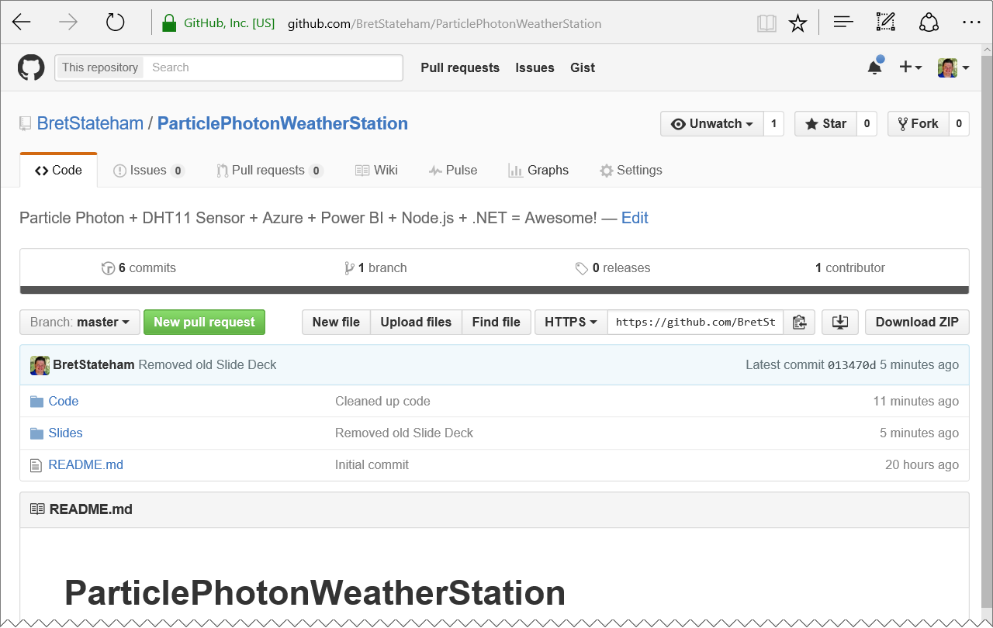
Grab the slides & code:
http://aka.ms/ppws

Slide 3
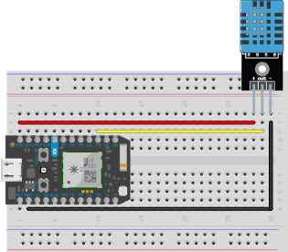
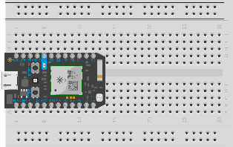
Solution ARCHITECTURE
<name>data
Power BI Data Set
Send
<name>job
Stream Analytics Job
<name>ns Service Bus Namespace
Receive
Logging
<name>hub
Event Hub
<name>storage
Storage Account
SEND
PublishToEventHub Webhook
Receive
Receive
ChkPt
“NodeClient”
Node.JS Receiver App
“NetClient”
.NET C# Console App Receiver

Slide 4
Solution ARCHITECTURE
<name>ns Service Bus Namespace
<name>hub
Event Hub

Slide 5
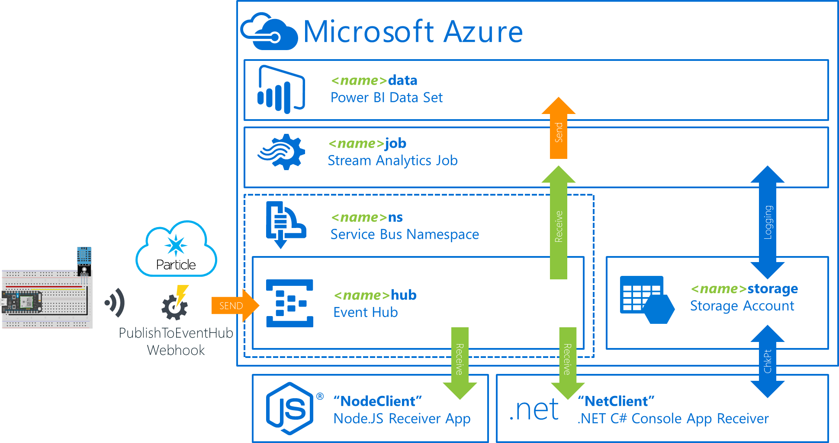
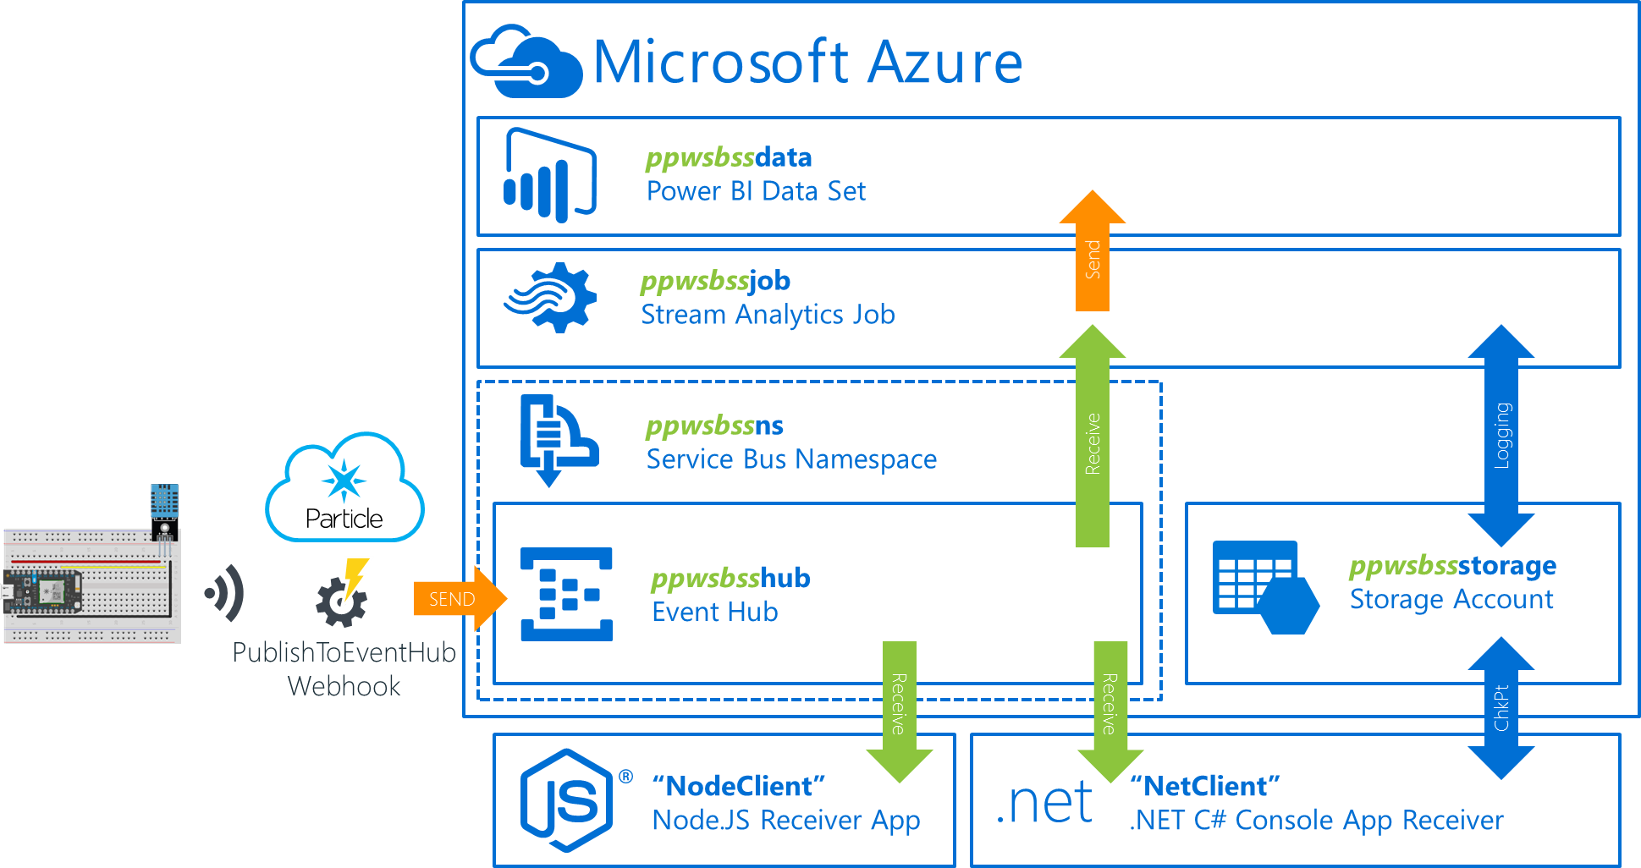
Coming up with a good <name>
It’s recommended that you use a consistent prefix when you name your objects in Azure
Many names need to be globally unique. Plus, a good prefix makes it easier to identify them, determine their role, and delete them later when you need to clean up.
The prefix is identified by the “<name>” placeholders in the architecture diagram.
I recommend using something like “ppws” (short for ParticlePhotonWeatherStation) and your initials. For example, for me
“ppwsbss”

Slide 6
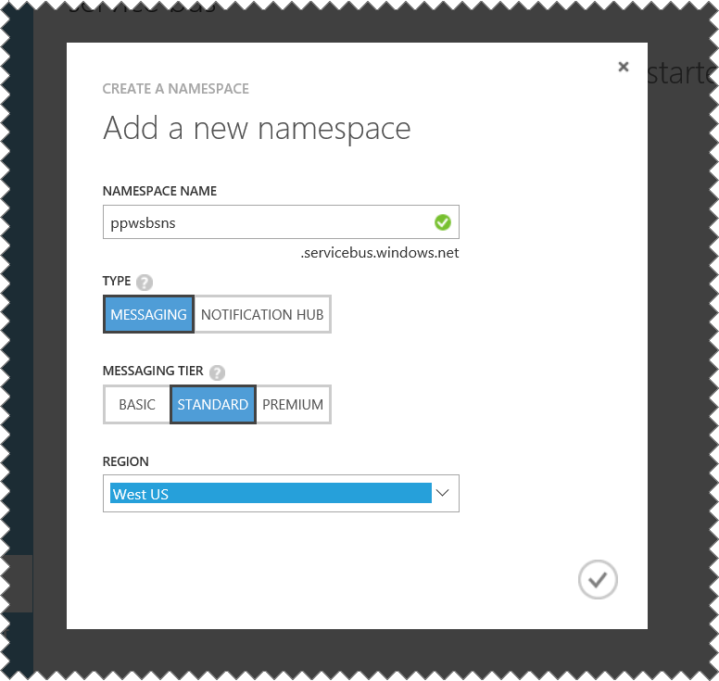
Using the same region
As you provision your resources in Azure you should use the same region for all of them.
This will decrease latency between them as well as reduce costs by eliminating data leaving one region as it travels to another.

Slide 7
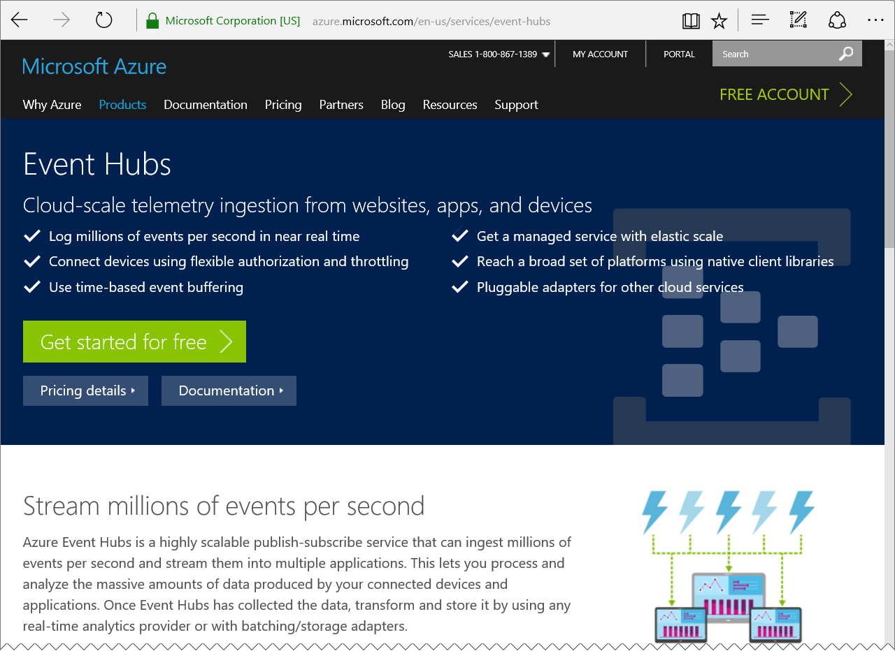
Azure event hubs
“Azure Event Hubs is a highly scalable publish-subscribe service that can ingest millions of events per second and stream them into multiple applications.”
Learn more here:
https://azure.microsoft.com/services/event-hubs/

Slide 8
Create the Azure Event Hub

Slide 9
Solution ARCHITECTURE
<name>ns Service Bus Namespace
<name>hub
Event Hub

Slide 10
Solution ARCHITECTURE
<name>ns Service Bus Namespace
<name>hub
Event Hub

Slide 11
Particle photon weather station Part 2 of 6: Particle Cloud and photon Prep
Particle Photon + DHT11 Sensor + Azure + Power BI + Node.js + .NET = AWESOME

Slide 12
Grab the slides & code:
http://aka.ms/ppws

Slide 13
Solution ARCHITECTURE
<name>data
Power BI Data Set
Send
<name>job
Stream Analytics Job
<name>ns Service Bus Namespace
Receive
Logging
<name>hub
Event Hub
<name>storage
Storage Account
SEND
PublishToEventHub Webhook
Receive
Receive
ChkPt
“NodeClient”
Node.JS Receiver App
“NetClient”
.NET C# Console App Receiver

Slide 14
Solution ARCHITECTURE
<name>ns Service Bus Namespace
<name>hub
Event Hub

Slide 15
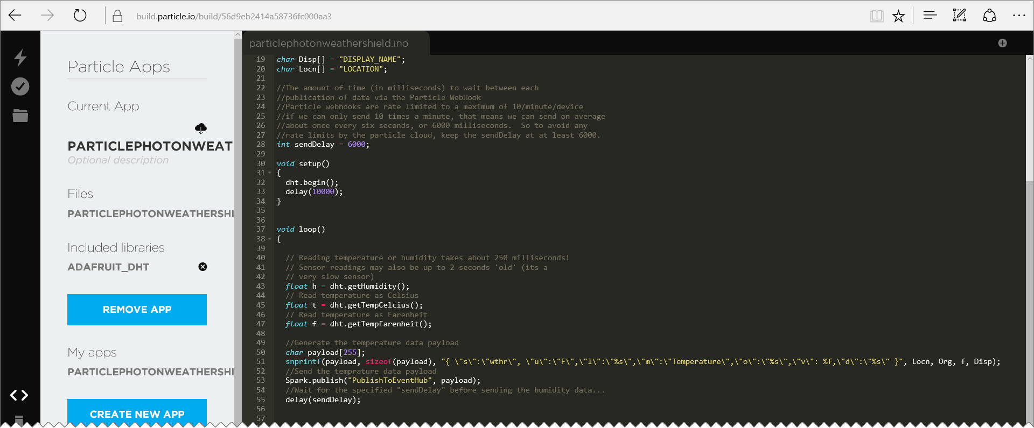
Particle “BUILD” browser IDE
https://build.particle.io

Slide 16
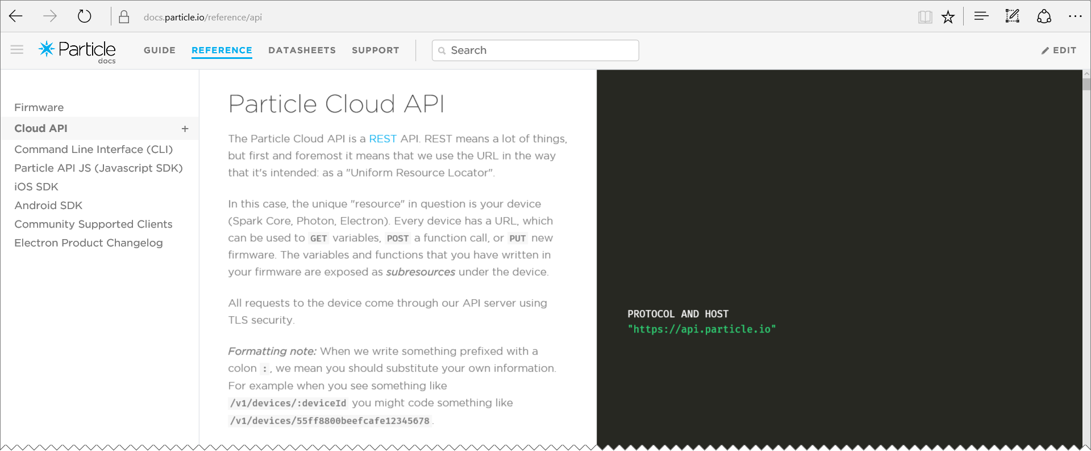
The particle cloud
https://docs.particle.io/reference/api/

Slide 17
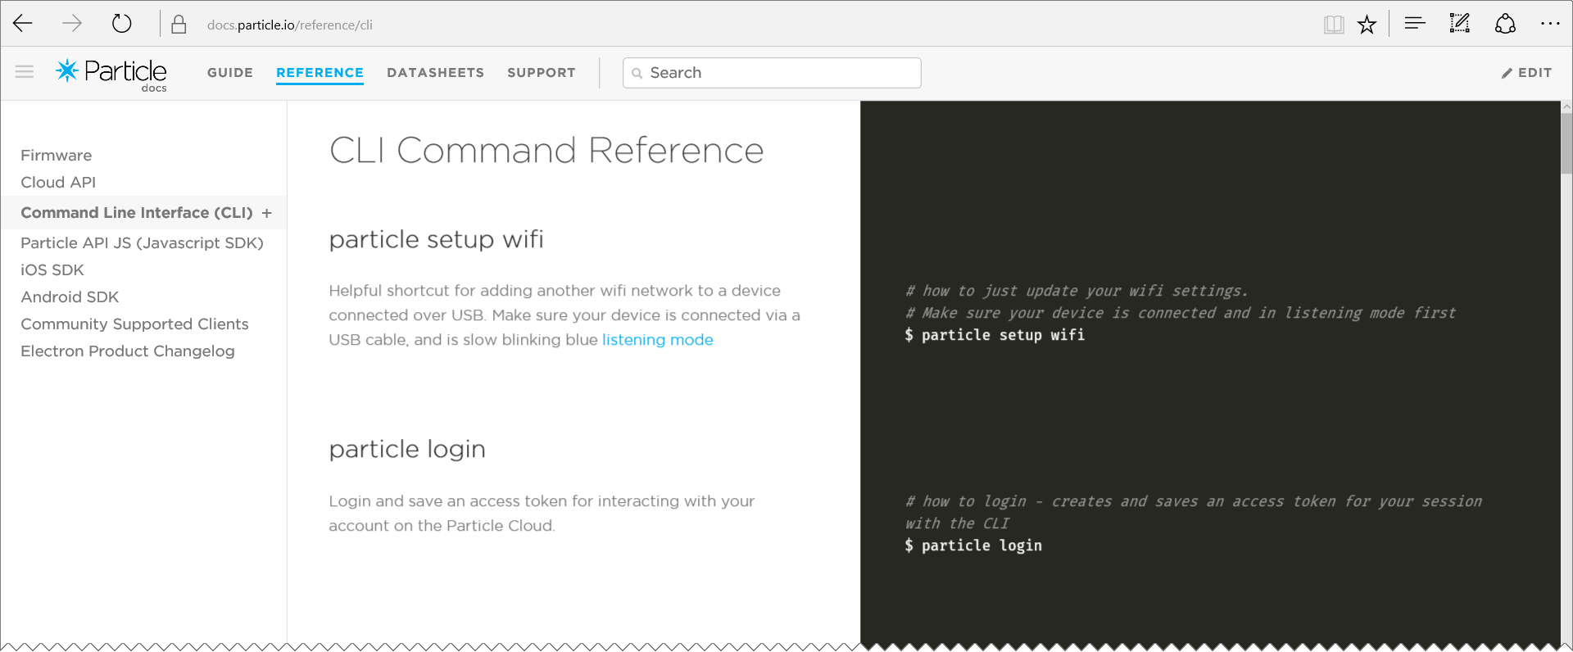
The particle-CLI
https://docs.particle.io/reference/cli/
REQUIRES NODE.JS

Slide 18
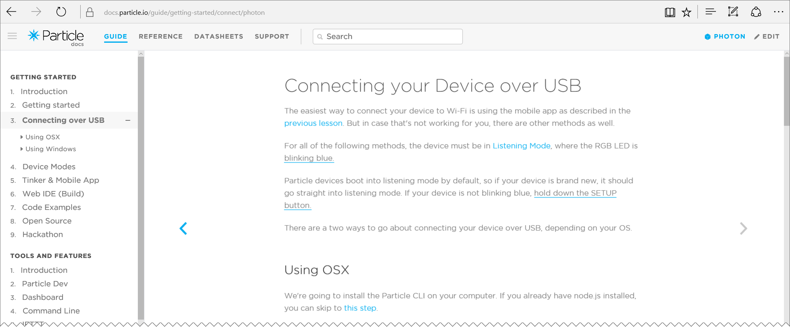
Claiming your Photon
https://docs.particle.io/guide/getting-started

Slide 19
Particle-cli login
You need to login to your particle cloud account from the cli (use your particle cloud login email and password): particle login
Of course you can also logout (provide your particle cloud password to completely logout): particle logout

Slide 20
Identify the attached photon
First find the COM port it is attached to: particle serial list
Then, get the device ID: particle serial identify <COM#>
Copy the Photon ID to your clipboard and save somewhere for later
PHOTON CONNECTED VIA USB AND IN LISTENING MODE
(Blinking blue)

Slide 21
Configure the particle wifi
From the command prompt: particle setup wifi Follow the prompts to connect the WiFi: <your wifi ssid> <your wifi security mode> <your wifi cypher type> <your wifi password>
PHOTON CONNECTED VIA USB AND IN LISTENING MODE
(Blinking blue)

Slide 22
Claim and name your photon
Add the device to your account particle device add <id>
Name the device particle device rename <id> <newname>
PHOTON ONLINE (BREATHING CYAN)

Slide 23
Configure the Particle Cloud and Photon

Slide 24
Solution ARCHITECTURE
<name>ns Service Bus Namespace
<name>hub
Event Hub

Slide 25
Solution ARCHITECTURE
<name>ns Service Bus Namespace
SEND
<name>hub
Event Hub
PublishToEventHub Webhook

Slide 26
Particle photon weather station Part 3 of 6: Photon DHT11 Circuit, WeBHOOK & CODE
Particle Photon + DHT11 Sensor + Azure + Power BI + Node.js + .NET = AWESOME

Slide 27
Grab the slides & code:
http://aka.ms/ppws

Slide 28
Solution ARCHITECTURE
<name>data
Power BI Data Set
Send
<name>job
Stream Analytics Job
<name>ns Service Bus Namespace
Receive
Logging
<name>hub
Event Hub
<name>storage
Storage Account
SEND
PublishToEventHub Webhook
Receive
Receive
ChkPt
“NodeClient”
Node.JS Receiver App
“NetClient”
.NET C# Console App Receiver

Slide 29
Solution ARCHITECTURE
<name>ns Service Bus Namespace
SEND
<name>hub
Event Hub
PublishToEventHub Webhook

Slide 30
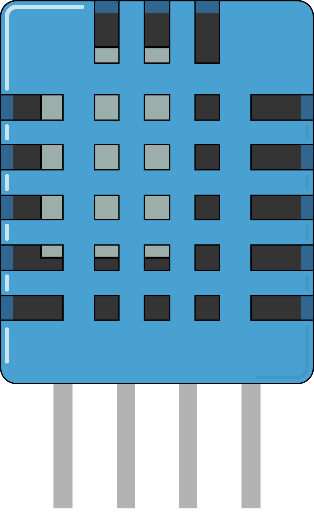
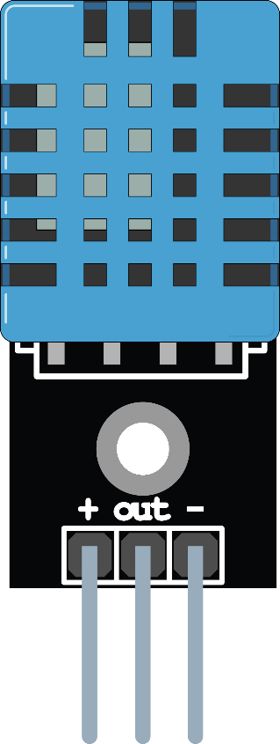
TWO TYPES OF DHT11 SENSORS
Standalone 4 Pin Sensor
(Requires external data line pullup resistor)
Pre-configured 3 Pin Sensor (Pullup resistor pre-installed on board)
Vcc
Gnd
Data
Not Used
Vcc
Gnd
Data

Slide 31
Standalone sensor pullup resistor
10KΩ
Vcc
Gnd
Data
Not Used

Slide 32
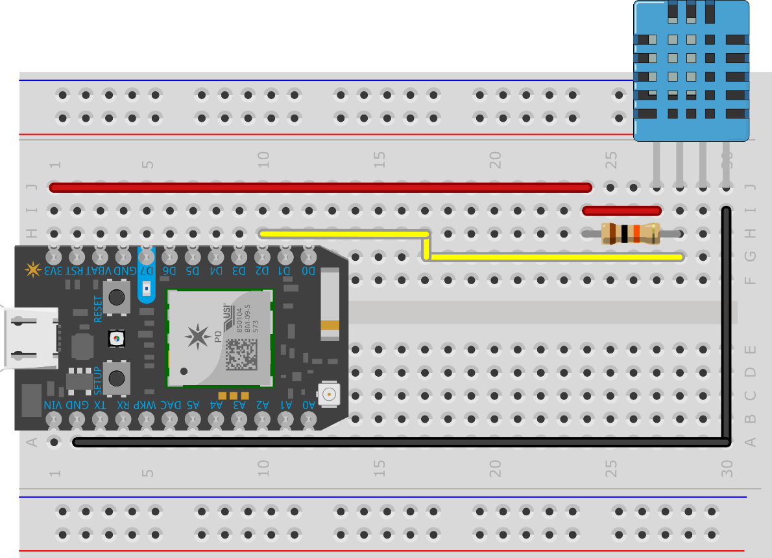
Standalone DHT11 CIRCUIT
10kΩ Pullup resistor Between the vcc pin and
the data pin

Slide 33
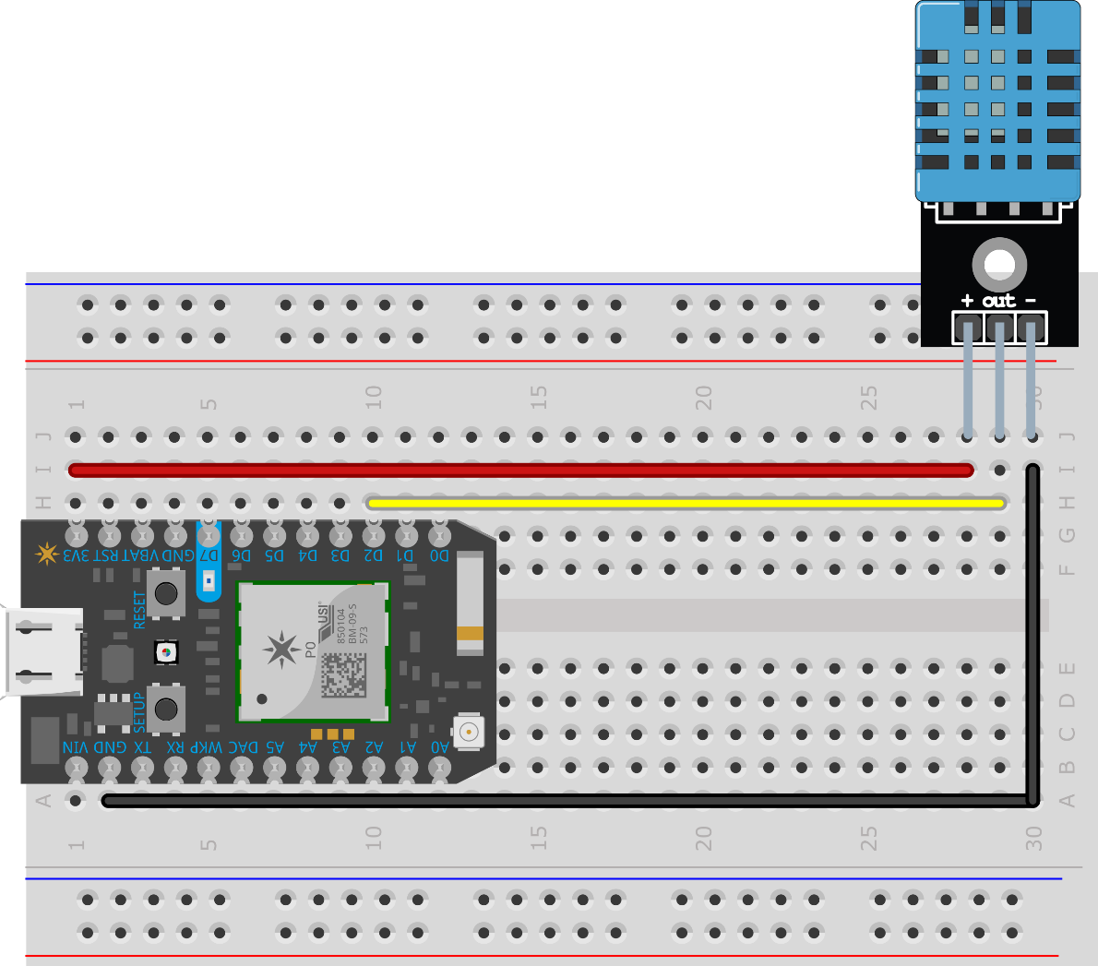
Pre-configured sensor circuit

Slide 34

Both use the same photon pins
PHOTON | DHT11
3V3 | Vcc
D2 | Data
GND | GND

Slide 35
Creating the Photon and DHT11 Circuit

Slide 36
CORRECTION - SPARK becomes PARTICLE
In May of 2015, “Spark” (the makers of the Photon) was renamed to “Particle”
That has some impact on the code, the Spark object that was used in code to access the Particle Cloud has been renamed to Particle instead. Makes sense.
Many of the upcoming slides, as well as the source code demoed reference the old Spark name. It still works, but has been deprecated. You should use the Particle object moving forward.
The slides and source in the http://aka.ms/ppws repo have been updated to use the new name as well, I just didn’t take the time to re-record the video.

Slide 37
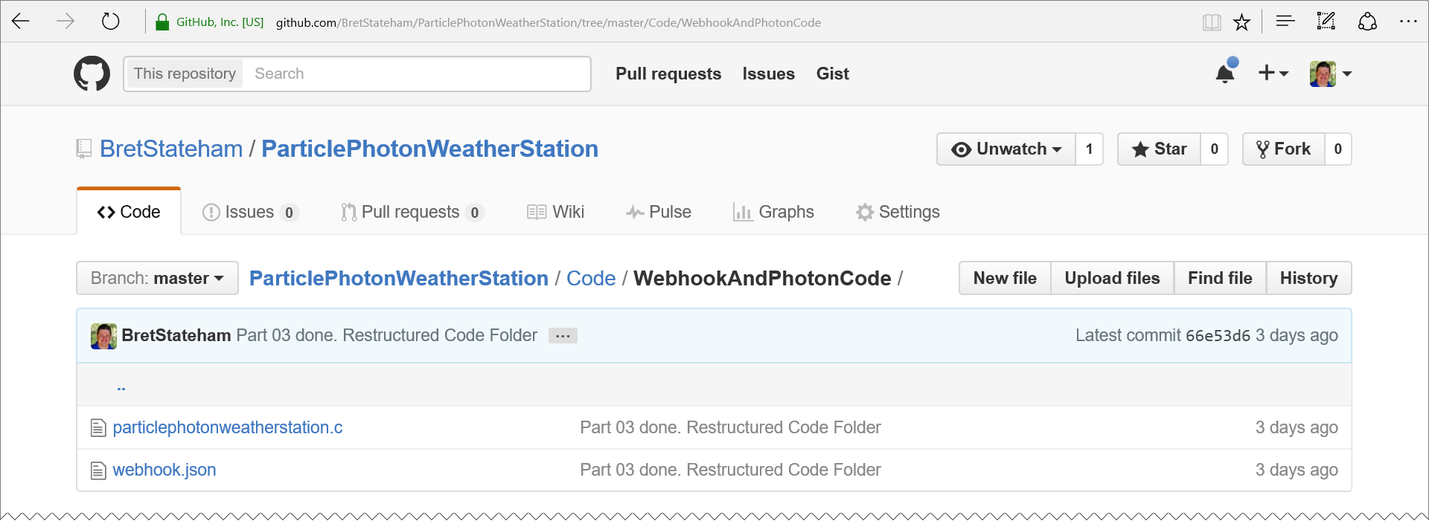
Groking the webhook
https://raw.githubusercontent.com/BretStateham/ParticlePhotonWeatherStation/master/Code/WebhookAndPhotonCode/webhook.json

Slide 38
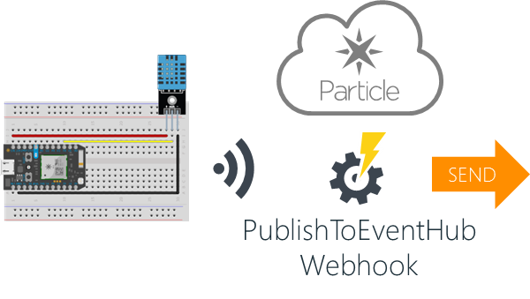
GROKING the webhook
Webhook.json
{
"event": "PublishToEventHub",
"url": "https://<YOUR_SERVICEBUS_NAME>.servicebus.windows.net/<YOUR_EVENTHUB_NAME>/messages",
"requestType": "POST",
"json": {
"subject": "{{s}}",
"unitofmeasure": "{{u}}",
"measurename": "{{m}}",
"value": "{{v}}",
"organization": "{{o}}",
"displayname": "{{d}}",
"location": "{{l}}",
"timecreated": "{{SPARK_PUBLISHED_AT}}",
"guid": "{{SPARK_CORE_ID}}"
},
"azure_sas_token": {
"key_name": "<YOUR_SAS_POLICY_NAME>",
"key": "<YOUR_SAS_POLICY_KEY>"
},
"mydevices": true
}

Slide 39
{
"event": "PublishToEventHub",
"url": "https://<YOUR_SERVICEBUS_NAME>.servicebus.windows.net/<YOUR_EVENTHUB_NAME>/messages",
"requestType": "POST",
"json": {
"subject": "{{s}}",
"unitofmeasure": "{{u}}",
"measurename": "{{m}}",
"value": "{{v}}",
"organization": "{{o}}",
"displayname": "{{d}}",
"location": "{{l}}",
"timecreated": "{{SPARK_PUBLISHED_AT}}",
"guid": "{{SPARK_CORE_ID}}"
},
"azure_sas_token": {
"key_name": "<YOUR_SAS_POLICY_NAME>",
"key": "<YOUR_SAS_POLICY_KEY>"
},
"mydevices": true
}

Slide 40
{
"event": "PublishToEventHub",
"url": "https://<YOUR_SERVICEBUS_NAME>.servicebus.windows.net/<YOUR_EVENTHUB_NAME>/messages",
"requestType": "POST",
"json": {
"subject": "{{s}}",
"unitofmeasure": "{{u}}",
"measurename": "{{m}}",
"value": "{{v}}",
"organization": "{{o}}",
"displayname": "{{d}}",
"location": "{{l}}",
"timecreated": "{{SPARK_PUBLISHED_AT}}",
"guid": "{{SPARK_CORE_ID}}"
},
"azure_sas_token": {
"key_name": "<YOUR_SAS_POLICY_NAME>",
"key": "<YOUR_SAS_POLICY_KEY>"
},
"mydevices": true
}
The name of the “event” that will invoke the webhook.
When you call Particle.publish(“PublishToEventHub", payload); from your Photon, the Particle cloud back end will trigger this webhook and publish your payload to the Azure Event Hub, specified by the “url”

Slide 41
{
"event": "PublishToEventHub",
"url": "https://<YOUR_SERVICEBUS_NAME>.servicebus.windows.net/<YOUR_EVENTHUB_NAME>/messages",
"requestType": "POST",
"json": {
"subject": "{{s}}",
"unitofmeasure": "{{u}}",
"measurename": "{{m}}",
"value": "{{v}}",
"organization": "{{o}}",
"displayname": "{{d}}",
"location": "{{l}}",
"timecreated": "{{SPARK_PUBLISHED_AT}}",
"guid": "{{SPARK_CORE_ID}}"
},
"azure_sas_token": {
"key_name": "<YOUR_SAS_POLICY_NAME>",
"key": "<YOUR_SAS_POLICY_KEY>"
},
"mydevices": true
}
The “url” of the Azure Event Hub that the data will be published to.
You will need to enter your own Service Bus namespace and event hub names in place of the <YOUR_SERVICEBUS_NAME> and <YOUR_EVENTHUB_NAME> placeholders

Slide 42
{
"event": "PublishToEventHub",
"url": "https://<YOUR_SERVICEBUS_NAME>.servicebus.windows.net/<YOUR_EVENTHUB_NAME>/messages",
"requestType": "POST",
"json": {
"subject": "{{s}}",
"unitofmeasure": "{{u}}",
"measurename": "{{m}}",
"value": "{{v}}",
"organization": "{{o}}",
"displayname": "{{d}}",
"location": "{{l}}",
"timecreated": "{{SPARK_PUBLISHED_AT}}",
"guid": "{{SPARK_CORE_ID}}"
},
"azure_sas_token": {
"key_name": "<YOUR_SAS_POLICY_NAME>",
"key": "<YOUR_SAS_POLICY_KEY>"
},
"mydevices": true
}
The data will be sent to the url using an HTTP POST

Slide 43
{
"event": "PublishToEventHub",
"url": "https://<YOUR_SERVICEBUS_NAME>.servicebus.windows.net/<YOUR_EVENTHUB_NAME>/messages",
"requestType": "POST",
"json": {
"subject": "{{s}}",
"unitofmeasure": "{{u}}",
"measurename": "{{m}}",
"value": "{{v}}",
"organization": "{{o}}",
"displayname": "{{d}}",
"location": "{{l}}",
"timecreated": "{{SPARK_PUBLISHED_AT}}",
"guid": "{{SPARK_CORE_ID}}"
},
"azure_sas_token": {
"key_name": "<YOUR_SAS_POLICY_NAME>",
"key": "<YOUR_SAS_POLICY_KEY>"
},
"mydevices": true
}
The json template is used to create the data for the message that will be sent to the Azure Event Hub

Slide 44
{
"event": "PublishToEventHub",
"url": "https://<YOUR_SERVICEBUS_NAME>.servicebus.windows.net/<YOUR_EVENTHUB_NAME>/messages",
"requestType": "POST",
"json": {
"subject": "{{s}}",
"unitofmeasure": "{{u}}",
"measurename": "{{m}}",
"value": "{{v}}",
"organization": "{{o}}",
"displayname": "{{d}}",
"location": "{{l}}",
"timecreated": "{{SPARK_PUBLISHED_AT}}",
"guid": "{{SPARK_CORE_ID}}"
},
"azure_sas_token": {
"key_name": "<YOUR_SAS_POLICY_NAME>",
"key": "<YOUR_SAS_POLICY_KEY>"
},
"mydevices": true
}
{
“s”: “Weather”,
“u”: “F”,
“m”: “Temperature”,
“v”: 79.234,
“o”: “Microsoft”,
“d”: “Bret’s PPWS” “l”: “San Diego”,
} Sample Payload from the Photon’s Particle.Publish call

Slide 45
{
"event": "PublishToEventHub",
"url": "https://<YOUR_SERVICEBUS_NAME>.servicebus.windows.net/<YOUR_EVENTHUB_NAME>/messages",
"requestType": "POST",
"json": {
"subject": "{{s}}",
"unitofmeasure": "{{u}}",
"measurename": "{{m}}",
"value": "{{v}}",
"organization": "{{o}}",
"displayname": "{{d}}",
"location": "{{l}}",
"timecreated": "{{SPARK_PUBLISHED_AT}}",
"guid": "{{SPARK_CORE_ID}}"
},
"azure_sas_token": {
"key_name": "<YOUR_SAS_POLICY_NAME>",
"key": "<YOUR_SAS_POLICY_KEY>"
},
"mydevices": true
}
The values:
SPARK_PUBLISHED_AT and SPARK_CORE_ID
Are supplied by the Particle cloud back end

Slide 46
{
"event": "PublishToEventHub",
"url": "https://<YOUR_SERVICEBUS_NAME>.servicebus.windows.net/<YOUR_EVENTHUB_NAME>/messages",
"requestType": "POST",
"json": {
"subject": "{{s}}",
"unitofmeasure": "{{u}}",
"measurename": "{{m}}",
"value": "{{v}}",
"organization": "{{o}}",
"displayname": "{{d}}",
"location": "{{l}}",
"timecreated": "{{SPARK_PUBLISHED_AT}}",
"guid": "{{SPARK_CORE_ID}}"
},
"azure_sas_token": {
"key_name": "<YOUR_SAS_POLICY_NAME>",
"key": "<YOUR_SAS_POLICY_KEY>"
},
"mydevices": true
}
The Shared-Access-Signature key name, and key value used to access the Azure Event Hub

Slide 47
{
"event": "PublishToEventHub",
"url": "https://<YOUR_SERVICEBUS_NAME>.servicebus.windows.net/<YOUR_EVENTHUB_NAME>/messages",
"requestType": "POST",
"json": {
"subject": "{{s}}",
"unitofmeasure": "{{u}}",
"measurename": "{{m}}",
"value": "{{v}}",
"organization": "{{o}}",
"displayname": "{{d}}",
"location": "{{l}}",
"timecreated": "{{SPARK_PUBLISHED_AT}}",
"guid": "{{SPARK_CORE_ID}}"
},
"azure_sas_token": {
"key_name": "<YOUR_SAS_POLICY_NAME>",
"key": "<YOUR_SAS_POLICY_KEY>"
},
"mydevices": true
}
Restricts the webhook to being triggered only from events published from your own devices

Slide 48
Create the particle webhook
From the command prompt, get in the same folder as the webhook.json file you downloaded, and run: particle webhook create webhook.json
Other particle-cli webhook commands include: particle webhook list particle webhook delete hookid

Slide 49
Creating the Webhook

Slide 50
Groking the code
https://raw.githubusercontent.com/BretStateham/ParticlePhotonWeatherStation/master/Code/WebhookAndPhotonCode/particlephotonweatherstation.c

Slide 51
Groking the photon code
// This #include statement was automatically added by the Spark IDE.
#include "Adafruit_DHT/Adafruit_DHT.h"
#define DHTPIN 2 // what pin we're connected to
// Uncomment whatever type you're using!
#define DHTTYPE DHT11// DHT 11
// ... Snip ...
DHT dht(DHTPIN, DHTTYPE);

Slide 52
Groking the photon code
char Org[] = "ORGANIZATION_NAME";
char Disp[] = "DISPLAY_NAME";
char Locn[] = "LOCATION";
//The amount of time (in milliseconds) to wait between each
//publication of data via the Particle WebHook
//Particle webhooks are rate limited to a maximum of 10/minute/device
//if we can only send 10 times a minute, that means we can send on average
//about once every six seconds, or 6000 milliseconds. So to avoid any
//rate limits by the particle cloud, keep the sendDelay at at least 6000.
int sendDelay = 6000;

Slide 53
Groking the photon code
void setup()
{
dht.begin();
Serial.begin(9600);
delay(10000);
}

Slide 54
Groking the photon code
void loop()
{
// Reading temperature or humidity takes about 250 milliseconds!
// Sensor readings may also be up to 2 seconds 'old' (its a
// very slow sensor)
float h = dht.getHumidity();
// Read temperature as Celsius
float t = dht.getTempCelcius();
// Read temperature as Farenheit
float f = dht.getTempFarenheit();

Slide 55
Groking the photon code
// Check if any reads failed. If any did, emit details to serial port for monitoring
// and exit the loop early (to try again).
if (isnan(h) || isnan(t) || isnan(f)) {
Serial.println("");
Serial.println("!!!!!!!!!!!!!!!!!!!!!!!!!!!!!!!!!!!!!!!!!!!!!!!!!!!!!!!!!!!!");
Serial.println("Failed to read from DHT sensor!");
Serial.println("h=" + String(h) + " t=" + String(t) + " f=" + String(f));
Serial.println("!!!!!!!!!!!!!!!!!!!!!!!!!!!!!!!!!!!!!!!!!!!!!!!!!!!!!!!!!!!");
Serial.println("");
return;
} // Emit the sensor values to the Serial port for monitoring
Serial.println();
Serial.println("----------");
Serial.println();
Serial.println("h=" + String(h) + " t=" + String(t) + " f=" + String(f));

Slide 56
Groking the photon code
// Generate the temperature data payload
char payload[255];
snprintf(payload, sizeof(payload), "{\"s\":\"Weather\", \"u\":\"F\", \"m\":\"Temperature\", \"v\": %f, \"o\":\"%s\", \"d\":\"%s\", \"l\":\"%s\"}", f,Org,Disp,Locn);
//Emit the payload to the serial port for monitoring purposes
Serial.println(payload);
// Send the temperature data payload
Particle.publish("PublishToEventHub", payload);
//Wait for the specified "sendDelay" before sending the humidity data...
delay(sendDelay);
{
“s”: “Weather”,
“u”: “F”,
“m”: “Temperature”,
“v”: 79.234,
“o”: “ORGANIZATION_NAME”,
“d”: “DISPLAY_NAME” “l”: “LOCATION”,
}

Slide 57
Groking the photon code
// Generate the humidity data payload
snprintf(payload, sizeof(payload), "{\"s\":\"Weather\", \"u\":\"%%\", \"m\":\"Humidity\", \"v\": %f, \"o\":\"%s\", \"d\":\"%s\", \"l\":\"%s\"}", h,Org,Disp,Locn);
// Emit the payload to the serial port for monitoring purposes
Serial.println(payload);
// Send the humidity data payload
Particle.publish("PublishToEventHub", payload);
// wait for the specified "sendDelay" before looping...
delay(sendDelay); } // End of loop()
{
“s”: “Weather”,
“u”: “F”,
“m”: “Temperature”,
“v”: 79.234,
“o”: “ORGANIZATION_NAME”,
“d”: “DISPLAY_NAME” “l”: “LOCATION”,
}

Slide 58
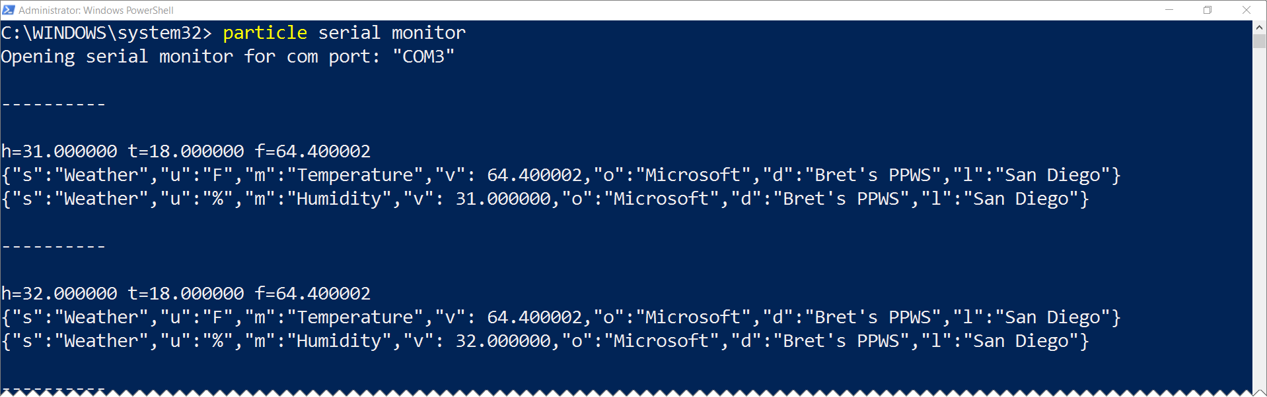
Monitoring photon via serial
particle serial monitor

Slide 59
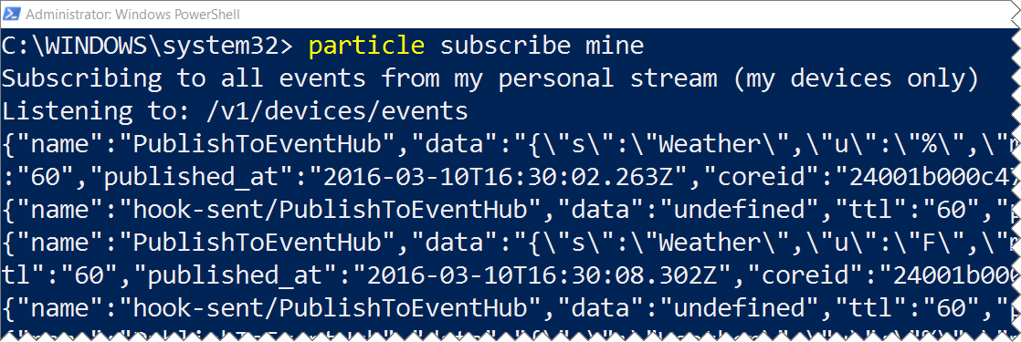
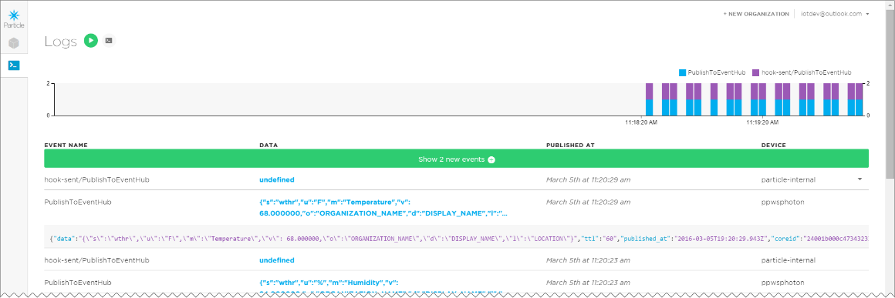
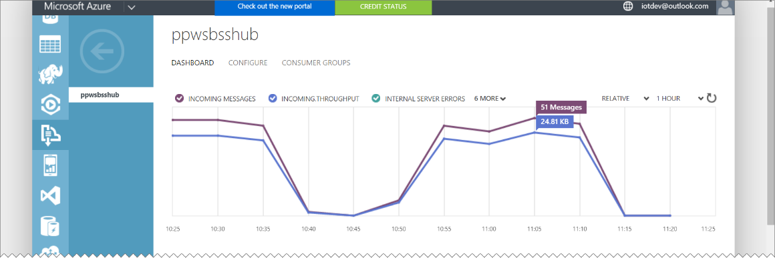
Monitoring webhook & event hub
Particle-cli: particle subscribe mine
Particle Dashboard: http://dashboard.particle.io/user/logs
Azure Portal: https://manage.windowsazure.com

Slide 60
Deploying the code

Slide 61
Solution ARCHITECTURE
<name>ns Service Bus Namespace
SEND
<name>hub
Event Hub
PublishToEventHub Webhook

Slide 62
Solution ARCHITECTURE
<name>data
Power BI Data Set
Send
<name>job
Stream Analytics Job
<name>ns Service Bus Namespace
Receive
Logging
<name>hub
Event Hub
<name>storage
Storage Account
SEND
PublishToEventHub Webhook

Slide 63
Particle photon weather station Part 4 0f 6: Reporting with Power BI
Particle Photon + DHT11 Sensor + Azure + Power BI + Node.js + .NET = AWESOME

Slide 64
Grab the slides & code:
http://aka.ms/ppws

Slide 65
Solution ARCHITECTURE
<name>data
Power BI Data Set
Send
<name>job
Stream Analytics Job
<name>ns Service Bus Namespace
Receive
Logging
<name>hub
Event Hub
<name>storage
Storage Account
SEND
PublishToEventHub Webhook
Receive
Receive
ChkPt
“NodeClient”
Node.JS Receiver App
“NetClient”
.NET C# Console App Receiver

Slide 66
Solution ARCHITECTURE
<name>data
Power BI Data Set
Send
<name>job
Stream Analytics Job
<name>ns Service Bus Namespace
Receive
Logging
<name>hub
Event Hub
<name>storage
Storage Account
SEND
PublishToEventHub Webhook

Slide 67
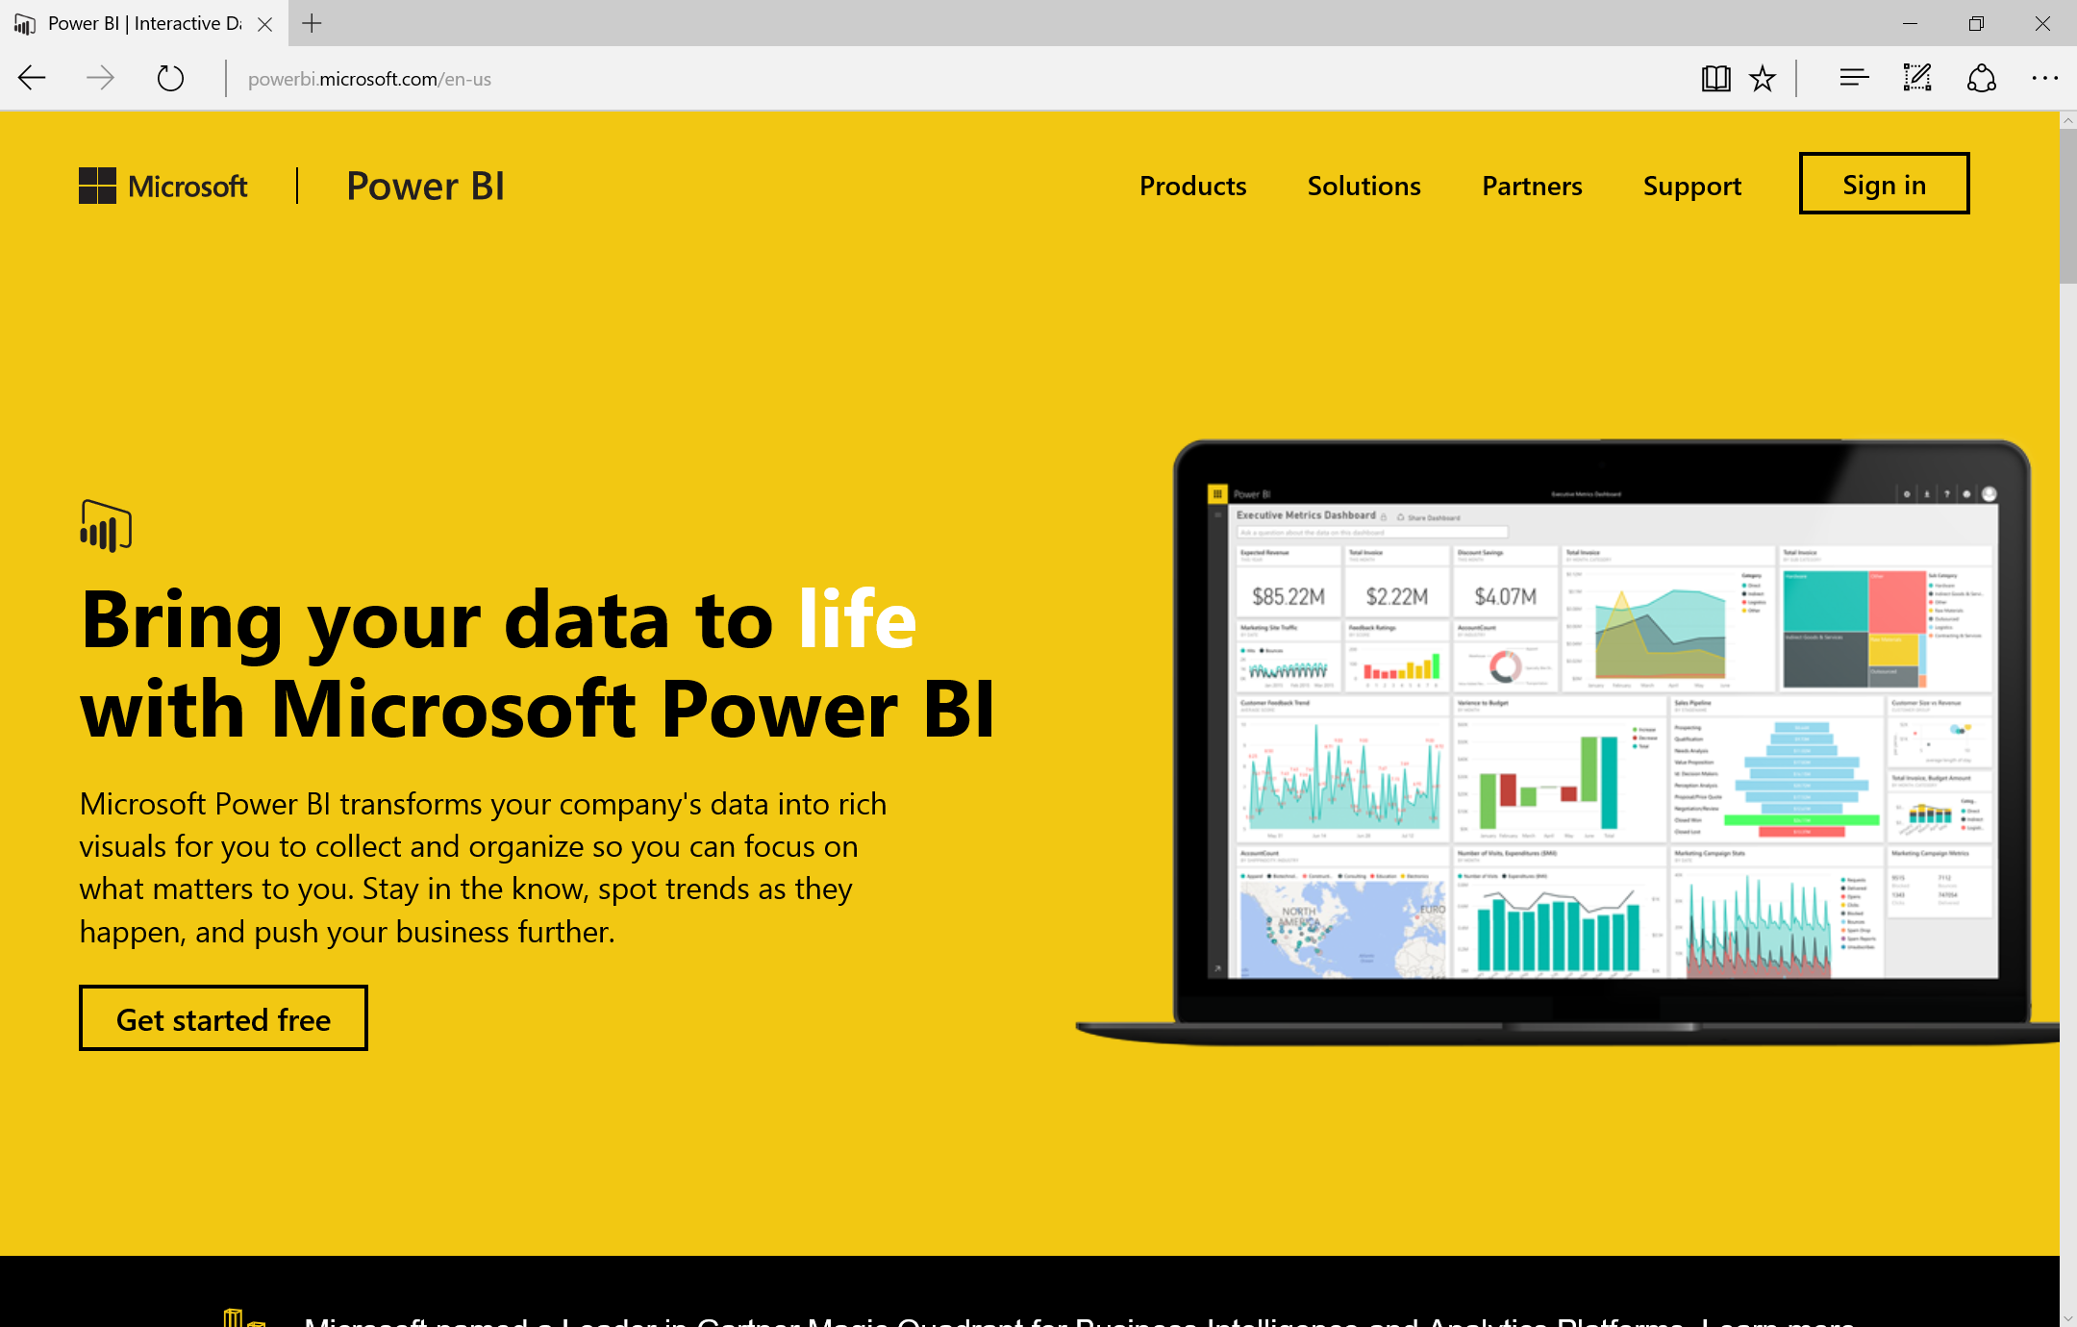
WHAT IS POWER BI?
Online Service for creating and sharing data sets, visualizations, reports and dashboards both within your organization as well as with others.

Slide 68
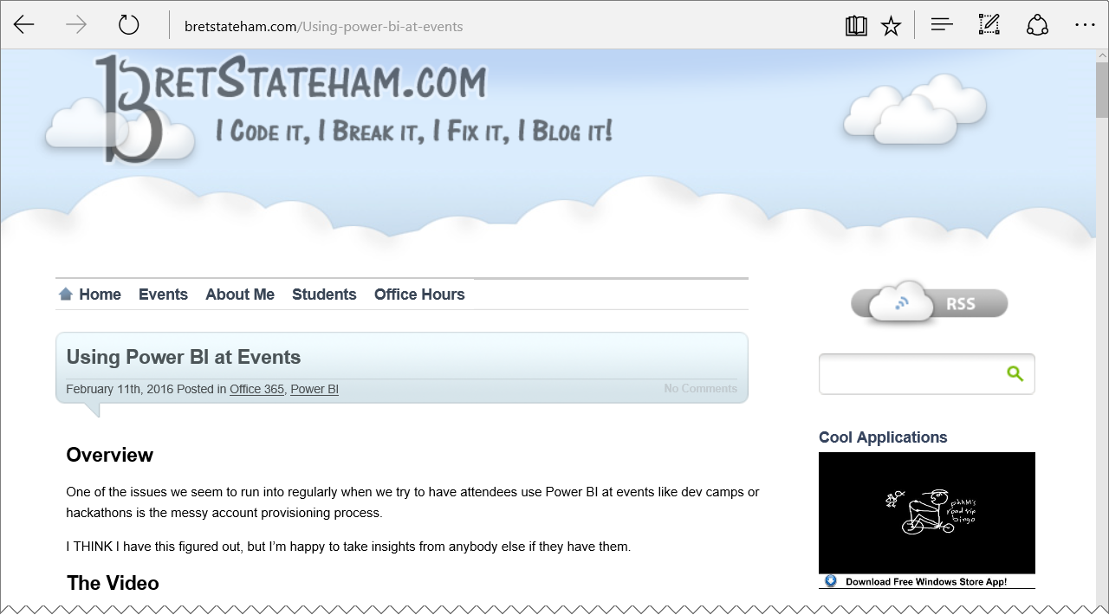
Signing up for power bi
You need an “organizational email” to sign up for Power BI.
You can’t use outlook.com, gmail.com, etc. personal accounts
Check out my blog post or Channel 9 video for more information
http://BretStateham.com/Using-power-bi-at-events

Slide 69
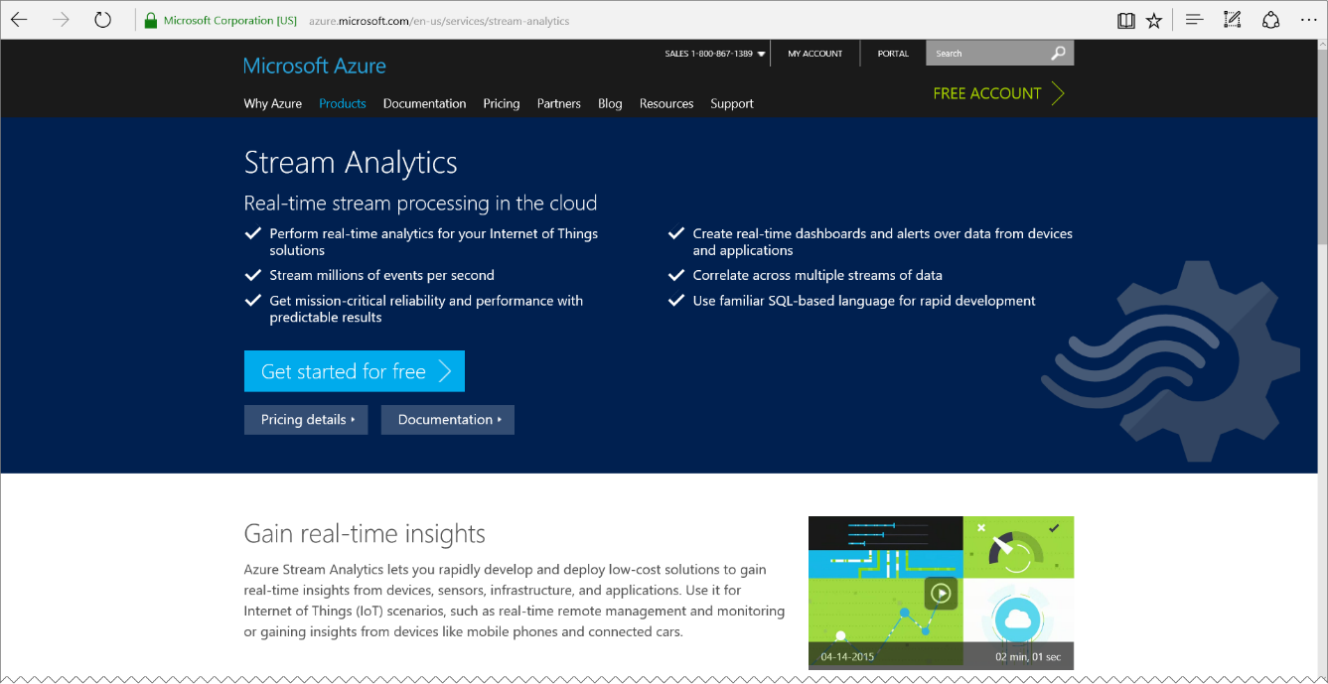
Stream analytics
Stream Analytics is integrated out-of-the-box with Azure Event Hubs to ingest millions of events per second. Stream Analytics processes ingested events in real-time, comparing multiple streams or comparing streams with historical values and models. It detects anomalies, transforms incoming data, triggers an alert when a specific error or condition appears in the stream, and displays this real-time data in your dashboard.
https://azure.microsoft.com/services/stream-analytics/

Slide 70
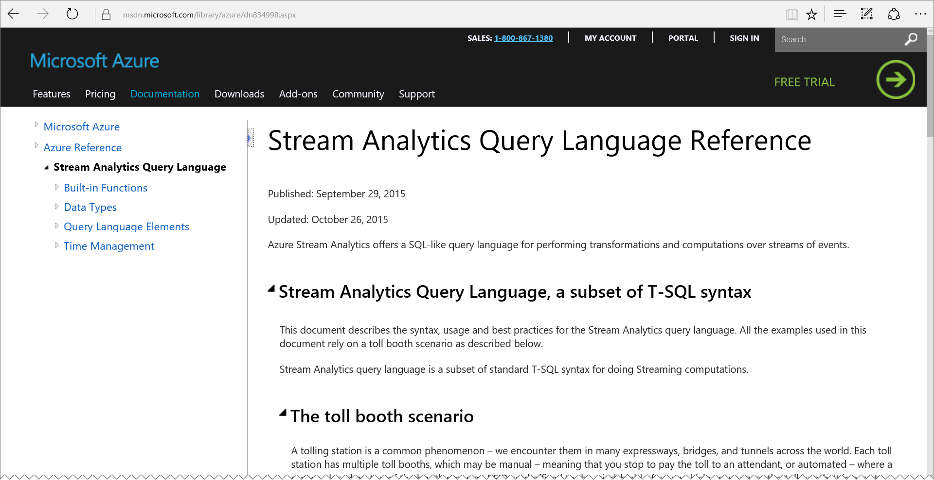
Stream analytics queries
A Subset of T-SQL
Can take data in from either streams (Event Hubs) or static data (Blobs) or relational data (SQL Database)
Can join multiple streams. For example you could join event hub message data with relational data from a database
Can output data to a streams, static data, databases, or Power BI.
Has powerful windowing functions for creating aggregations over Tumbling, Hopping or Sliding time windows
https://msdn.microsoft.com/library/azure/dn834998.aspx

Slide 71
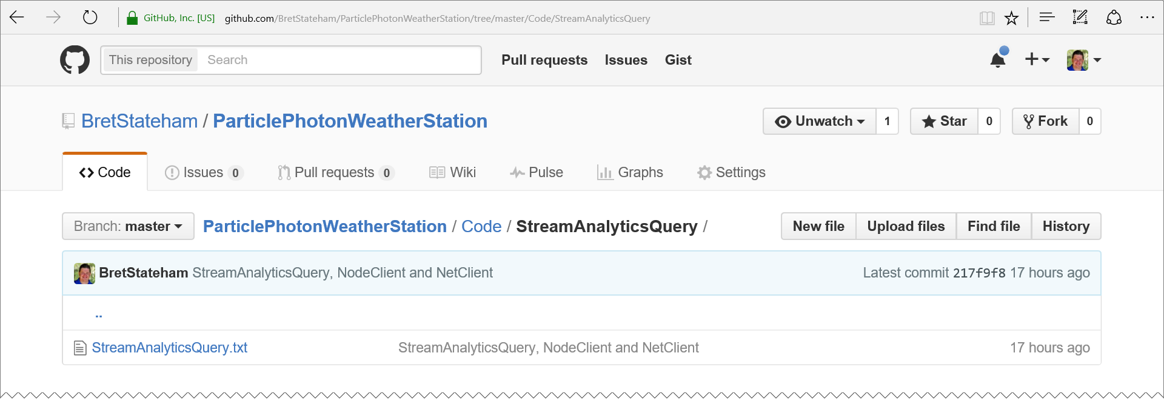
Groking the stream analytics query
https://raw.githubusercontent.com/BretStateham/ParticlePhotonWeatherStation/master/Code/StreamAnalyticsQuery/StreamAnalyticsQuery.txt

Slide 72
Groking the stream analytics query
Issuing the “CREATE TABLE” statement before the query allows us to define the schema of the data. Any incoming messages that don’t meet this schema will be rejected. This helps prevent the Stream Analytics job from failing on invalid messages.
Notice that some of the fields are from the JSON payload generated by the Photon, and then the Particle Webhook (like measurename, unitofmeasure and value) while others are system generated values (like EventEnqueuedUtcTime or PartitionId)
CREATE TABLE ppwsbsshub (
coreid nvarchar(max),
data nvarchar(max),
displayname nvarchar(max),
event nvarchar(max),
EventEnqueuedUtcTime datetime,
EventProcessedUtcTime datetime,
guid nvarchar(max),
location nvarchar(max),
measurename nvarchar(max),
organization nvarchar(max),
PartitionId bigint,
published_at datetime,
subject nvarchar(max),
timecreated datetime,
unitofmeasure nvarchar(max),
value float
);

Slide 73
Groking the stream analytics query
The “SELECT” statement defines the final values that will be output to the Power BI data set. We really aren’t taking much advantage of Stream Analytics processing capabilities here, we’re just forwarding the data long.
You could however be using Stream Analytics time windowing functions and SQL aggregations to generate summary values or even generate alert data based on data anomalies.
SELECT
coreid
,displayname
,event
,EventEnqueuedUtcTime
,EventProcessedUtcTime
,guid
,location
,measurename
,organization
,PartitionId
,published_at
,subject
,timecreated
,unitofmeasure
,value
INTO
<name>data
FROM
<name>hub;
Power BI data set the data will be sent INTO
Event Hub source messages will come FROM

Slide 74
Reporting with Power BI

Slide 75
Solution ARCHITECTURE
<name>data
Power BI Data Set
Send
<name>job
Stream Analytics Job
<name>ns Service Bus Namespace
Receive
Logging
<name>hub
Event Hub
<name>storage
Storage Account
SEND
PublishToEventHub Webhook

Slide 76
Solution ARCHITECTURE
<name>data
Power BI Data Set
Send
<name>job
Stream Analytics Job
<name>ns Service Bus Namespace
Receive
Logging
<name>hub
Event Hub
<name>storage
Storage Account
SEND
PublishToEventHub Webhook
Receive
“NodeClient”
Node.JS Receiver App

Slide 77
Particle photon weather station Part 5 of 6: RECEIVING EVENTS with Node.js
Particle Photon + DHT11 Sensor + Azure + Power BI + Node.js + .NET = AWESOME

Slide 78
Grab the slides & code:
http://aka.ms/ppws

Slide 79
Solution ARCHITECTURE
<name>data
Power BI Data Set
Send
<name>job
Stream Analytics Job
<name>ns Service Bus Namespace
Receive
Logging
<name>hub
Event Hub
<name>storage
Storage Account
SEND
PublishToEventHub Webhook
Receive
Receive
ChkPt
“NodeClient”
Node.JS Receiver App
“NetClient”
.NET C# Console App Receiver

Slide 80
Solution ARCHITECTURE
<name>data
Power BI Data Set
Send
<name>job
Stream Analytics Job
<name>ns Service Bus Namespace
Receive
Logging
<name>hub
Event Hub
<name>storage
Storage Account
SEND
PublishToEventHub Webhook
Receive
“NodeClient”
Node.JS Receiver App

Slide 81
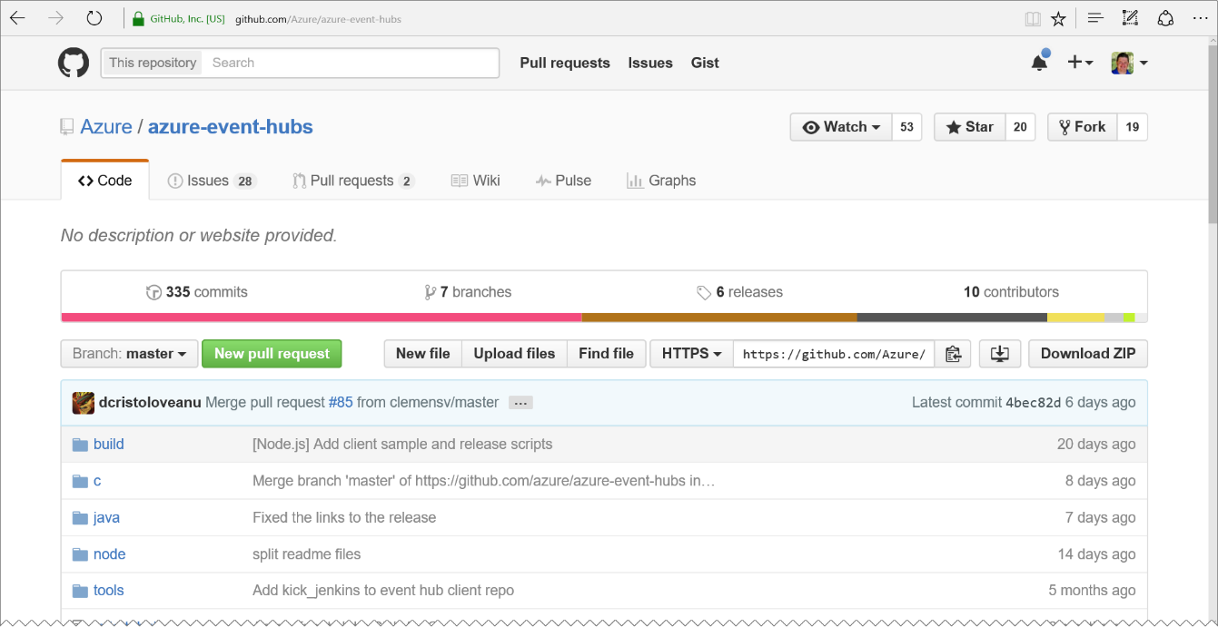
Azure-event-hubs repository
Azure Event Hub clients for
C
Java
Node.js
We’ll be using the “Node” client implementation in the upcoming demo.
https://github.com/Azure/Azure-event-hubs

Slide 82
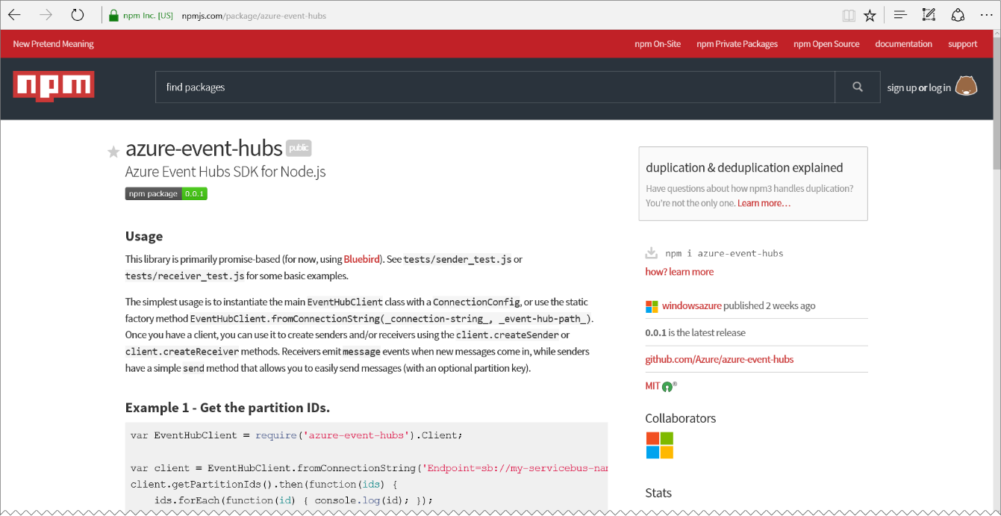
Azure-event-hubs NPM PACKAGE
Simplifies adding the Azure-Event-Hubs functionality to your Node packages
Depends on the Bluebird package’s promise implementation for async operations
npm install Bluebird
npm install Azure-Event-Hubs
https://www.npmjs.com/package/azure-event-hubs

Slide 83
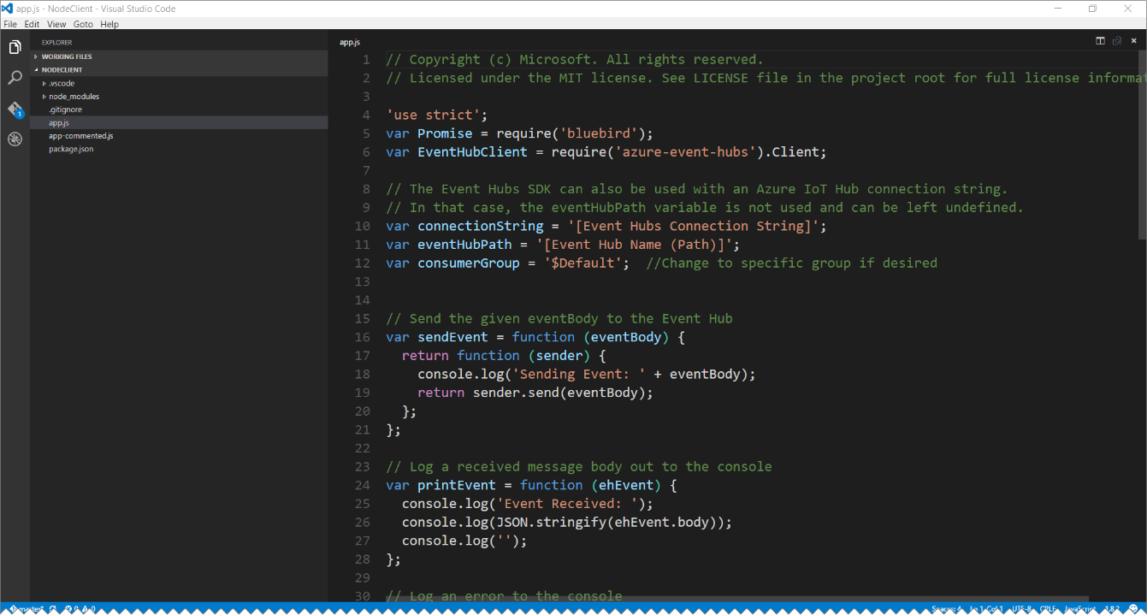
Visual studio code for node dev
Visual Studio Code is a great development environment for Node.js applications.
Not only can you edit your code in VS Code, but you can do step-through debugging as well as git source control integration. Check it out!
https://code.visualstudio.com/

Slide 84
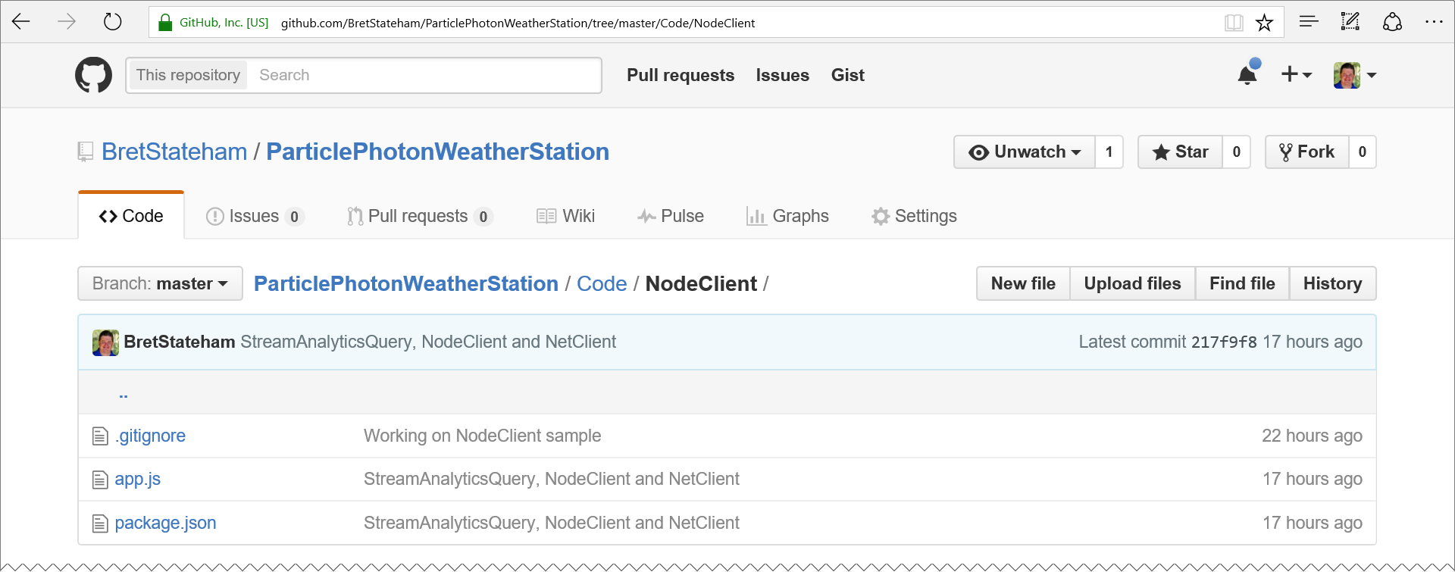
Groking the stream analytics query
https://raw.githubusercontent.com/BretStateham/ParticlePhotonWeatherStation/master/Code/NodeClient/app.js

Slide 85
Groking the node code
'use strict';
var Promise = require('bluebird');
var EventHubClient = require('azure-event-hubs').Client;
var moment = require('moment');

Slide 86
Groking the node code
// The Event Hubs SDK can also be used with an Azure IoT Hub connection string.
// In that case, the eventHubPath variable is not used and can be left undefined.
var connectionString = '[Event Hub Connection String]';
var eventHubPath = '[Event Hub Name (Path)]';
var client = EventHubClient.fromConnectionString(connectionString, eventHubPath);
// Set the consumer group and start time offset for the event hub receivers
// If you have created a consumer group for your node app to use, enter it here
var consumerGroup = '$Default';
// Set the consumer up to receive only new messages, not all the old ones as well
// set receiveAfterTime to null to read all of the messages from the beginning
var receiveAfterTime = Date.now() - 5000;

Slide 87
Groking the node code
// Log a received message body out to the console
var printEvent = function (ehEvent) {
var body = ehEvent.body
var created = moment(body.timecreated);
var val = Number(body.value);
console.log(created.format("hh:mm:ss a") + " - " + body.measurename + ": " + val.toFixed(2) + body.unitofmeasure);
};
// Log an error to the console
var printError = function (err) {
console.error(err.message);
};

Slide 88
Groking the node code
// Send the given eventBody to the Event Hub
var sendEvent = function (eventBody) {
return function (sender) {
console.log('Sending Event: ' + eventBody);
return sender.send(eventBody);
};
};

Slide 89
Groking the node code
client.open()
.then(client.getPartitionIds.bind(client))
.then(function (partitionIds) {
return partitionIds.map(function (partitionId) {
return client.createReceiver(
consumerGroup,
partitionId,
{ 'startAfterTime': receiveAfterTime }
).then(function (receiver) {
receiver.on('errorReceived', printError);
receiver.on('message', printEvent);
});
});
})

Slide 90
Groking the node code
// The send commands have been commented out since we want to just receive
// messages from the Photon sender, but you can see how you could use this code
// to send messages as well..
// .then(client.createSender.bind(client))
// .then(sendEvent('foo'))
.catch(printError);

Slide 91
Groking the node code
'use strict';
var Promise = require('bluebird');
var EventHubClient = require('azure-event-hubs').Client;
var moment = require(‘moment');
// The Event Hubs SDK can also be used with an Azure IoT Hub connection string.
// In that case, the eventHubPath variable is not used and can be left undefined.
var connectionString = '[Event Hubs Connection String]';
var eventHubPath = '[Event Hub Name (Path)]';
var consumerGroup = '$Default'; //Change to specific group if desired

Slide 92
Groking the node code
// Send the given eventBody to the Event Hub
var sendEvent = function (eventBody) {
return function (sender) {
console.log('Sending Event: ' + eventBody);
return sender.send(eventBody);
};
};
// Log a received message body out to the console
var printEvent = function (ehEvent) {
console.log('Event Received: ');
console.log(JSON.stringify(ehEvent.body));
console.log('');
};
// Log an error to the console
var printError = function (err) {
console.error(err.message);
};

Slide 93
Groking the node code
var client = EventHubClient.fromConnectionString(connectionString, eventHubPath);
var receiveAfterTime = Date.now() - 5000;
client.open()
.then(client.getPartitionIds.bind(client))
.then(function (partitionIds) {
return partitionIds.map(function (partitionId) {
return client.createReceiver(
consumerGroup,
partitionId,
{ 'startAfterTime': receiveAfterTime }
).then(function (receiver) {
receiver.on('errorReceived', printError);
receiver.on('message', printEvent);
});
});
})

Slide 94
Groking the node code
// The send commands have been commented out since we want to just receive
// messages from the Photon sender, but you can see how you could use this code
// to send messages as well..
// .then(client.createSender.bind(client))
// .then(sendEvent('foo'))
.catch(printError);

Slide 95
Receiving Events Hub Messages with Node.js

Slide 96
Solution ARCHITECTURE
<name>data
Power BI Data Set
Send
<name>job
Stream Analytics Job
<name>ns Service Bus Namespace
Receive
Logging
<name>hub
Event Hub
<name>storage
Storage Account
SEND
PublishToEventHub Webhook
Receive
“NodeClient”
Node.JS Receiver App

Slide 97
Solution ARCHITECTURE
<name>data
Power BI Data Set
Send
<name>job
Stream Analytics Job
<name>ns Service Bus Namespace
Receive
Logging
<name>hub
Event Hub
<name>storage
Storage Account
SEND
PublishToEventHub Webhook
Receive
Receive
ChkPt
“NodeClient”
Node.JS Receiver App
“NetClient”
.NET C# Console App Receiver

Slide 98
Particle photon weather station Part 6 of 6: RECEIVING EVENTS with C#
Particle Photon + DHT11 Sensor + Azure + Power BI + Node.js + .NET = AWESOME

Slide 99
Grab the slides & code:
http://aka.ms/ppws

Slide 100
Solution ARCHITECTURE
<name>data
Power BI Data Set
Send
<name>job
Stream Analytics Job
<name>ns Service Bus Namespace
Receive
Logging
<name>hub
Event Hub
<name>storage
Storage Account
SEND
PublishToEventHub Webhook
Receive
Receive
ChkPt
“NodeClient”
Node.JS Receiver App
“NetClient”
.NET C# Console App Receiver

Slide 101
Solution ARCHITECTURE
<name>data
Power BI Data Set
Send
<name>job
Stream Analytics Job
<name>ns Service Bus Namespace
Receive
Logging
<name>hub
Event Hub
<name>storage
Storage Account
SEND
PublishToEventHub Webhook
Receive
Receive
ChkPt
“NodeClient”
Node.JS Receiver App
“NetClient”
.NET C# Console App Receiver

Slide 102
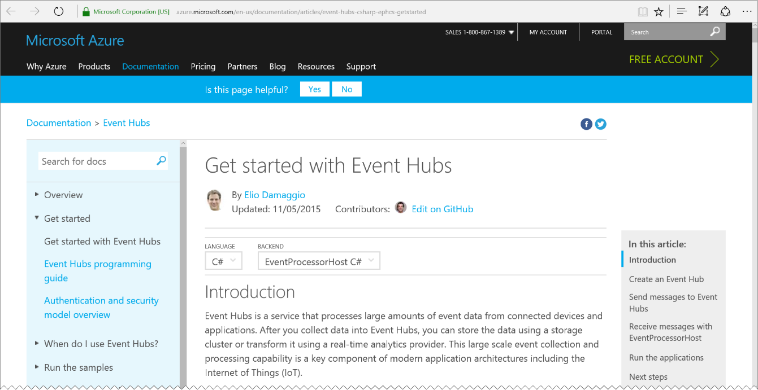
.NET Event hub client tutorial
Get started using Event Hubs from C#. This tutorial helps you create both a sender and a receiver using the “Microsoft Azure Service Bus” and “Microsoft Azure Service Bus Event Hub - EventProcessorHost” NuGet packages.
http://aka.ms/ehcs

Slide 103
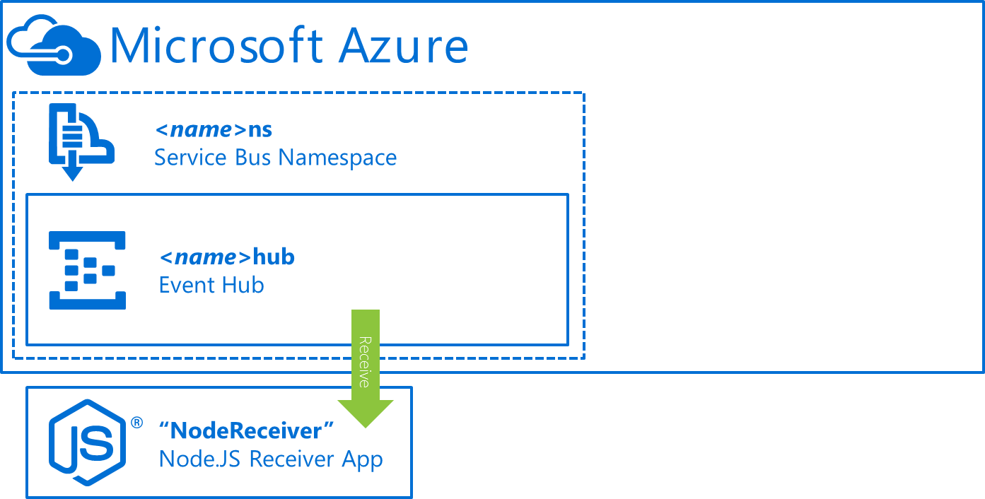
Azure storage requirement
The Node.js sample app didn’t require an Azure Storage Account.
The Azure-Event-Hubs node client doesn’t have any built-in “checkpointing” that allows clients to pick up where they left off.
If you want that behavior, you have to implement it yourself. You could CHOOSE to use Azure Storage as a place to store that checkpoint data, but that is up to you

Slide 104
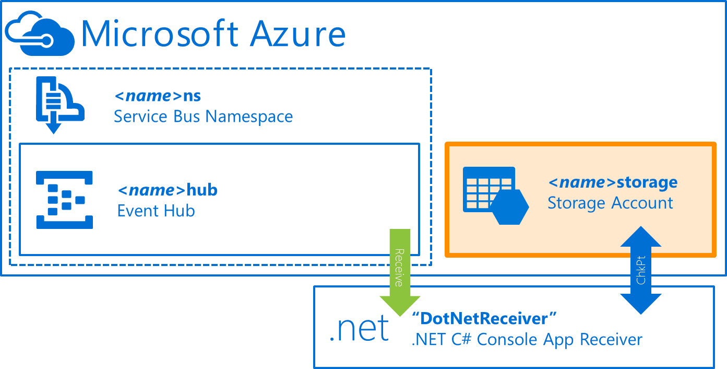
Azure storage requirement
The EventProcessHost class provided by Microsoft for .NET clients though DOES have built-in checkpointing, and it REQUIRES an Azure Storage account to store that checkpoint data in.
If you prefer to not use Azure Storage you will need to implement your own .NET client using the Azure Service Bus or AMQP apis.

Slide 105
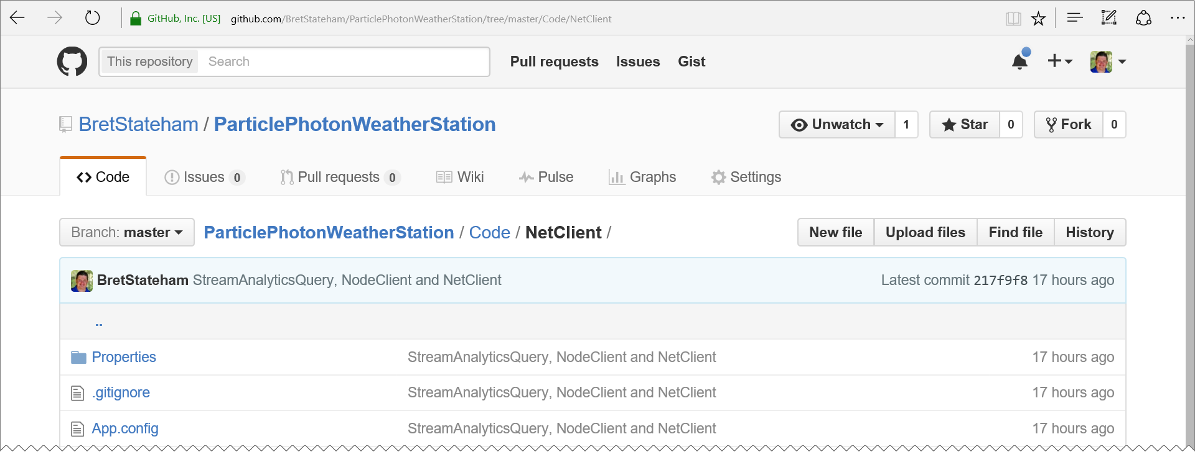
Groking the .NET CODE
https://github.com/BretStateham/ParticlePhotonWeatherStation/tree/master/Code/NetClient

Slide 106
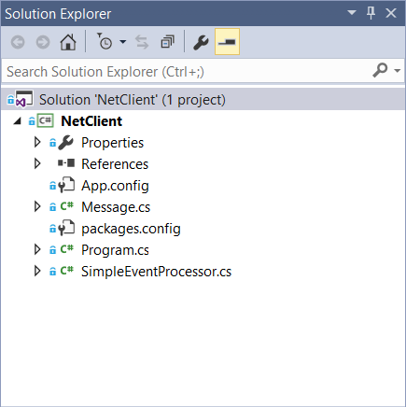
Groking the .net code
Message.cs defines the data structure. Each message from our Photon (via the Particle Cloud and the Event Hub) will end up in one of these.
SimpleEventProcessor.cs handles the opening and closing of an Event Hub partition, and the de-serializing of received messages into Message instances
Program.cs is the main console app program. It initializes the EventProcessorHost with the Event Hub and Storage Account settings and kicks off the receiving of messages.

Slide 107
Groking the .nET code - Message.cs
public class Message
{
// ...snip...
private string unitOfMeasure;
public string UnitOfMeasure
{
get { return unitOfMeasure; }
set { unitOfMeasure = value; }
}
private string measureName;
public string MeasureName
{
get { return measureName; }
set { measureName = value; }
}
private float value;
public float Value
{
get { return value; }
set { this.value = value; }
}
// ...snip...
}
The “Message” class is used to de-serialize the JSON data received from the event hub.
The various properties we published from the Photon via the Particle Cloud, like “measurename”, “unitofmeasure”, “value”, etc. get de-serialized into this strongly typed object for easy use.
Cool, eh!?

Slide 108
Groking the .nET code - SimpleEventProcessor.cs
class SimpleEventProcessor : IEventProcessor
{
Stopwatch checkpointStopwatch;
public Task OpenAsync(PartitionContext context)
{
Console.WriteLine(
"SimpleEventProcessor initialized. Partition: '{0}', Offset: '{1}'", context.Lease.PartitionId, context.Lease.Offset);
checkpointStopwatch = new Stopwatch();
checkpointStopwatch.Start();
return Task.FromResult<object>(null);
}

Slide 109
Groking the .nET code - SimpleEventProcessor.cs
public async Task CloseAsync(PartitionContext context, CloseReason reason)
{
Console.WriteLine(
"Processor Shutting Down. Partition: '{0}', Reason: '{1}'", context.Lease.PartitionId, reason);
if (reason == CloseReason.Shutdown)
{
await context.CheckpointAsync();
}
}

Slide 110
Groking the .nET code - SimpleEventProcessor.cs
public async Task ProcessEventsAsync(PartitionContext context, IEnumerable<EventData> messages)
{
foreach (EventData eventData in messages)
{

Slide 111
Groking the .nET code - SimpleEventProcessor.cs
try
{
Message message;
string data = Encoding.UTF8.GetString(eventData.GetBytes());
message = JsonConvert.DeserializeObject<Message>(data);
Console.WriteLine(string.Format("{0:hh:mm:ss tt} - {1}: {2:0.00}{3}", message.TimeCreated.ToLocalTime(), message.MeasureName, message.Value, message.UnitOfMeasure));
}
catch (Exception ex)
{
string exMessage = string.Format( "\n!!!!!!!!!!\nA {0} occurred when deserializing the message: \n{1}\n!!!!!!!!!!\n", ex.GetType().Name, ex.Message);
Console.WriteLine(exMessage);
Debug.WriteLine(exMessage);
}

Slide 112
Groking the .nET code - SimpleEventProcessor.cs
// Call checkpoint every five minutes, so that worker can resume processing // from 5 minutes back if it restarts.
if (this.checkpointStopwatch.Elapsed > TimeSpan.FromMinutes(5))
{
await context.CheckpointAsync();
this.checkpointStopwatch.Restart();
}
} // End foreach loop
} // End ProcessEventsAsync method } // SimpleEventProcessor class

Slide 113
Groking the .nET code - PROGRAM.cs
class Program
{
static void Main(string[] args)
{
string eventHubConnectionString = "[Event Hub Connection String]";
string eventHubName = "[Event Hub Name (Path)]";
string consumerGroupName = EventHubConsumerGroup.DefaultGroupName;
string storageAccountName = "[Storage Account Name]";
string storageAccountKey = "[Storage Account Key]";
string storageConnectionString = string.Format( "DefaultEndpointsProtocol=https;AccountName={0};AccountKey={1}", storageAccountName, storageAccountKey);
string eventProcessorHostName = Guid.NewGuid().ToString();
EventProcessorHost eventProcessorHost = new EventProcessorHost(
eventProcessorHostName, eventHubName, consumerGroupName, eventHubConnectionString, storageConnectionString);

Slide 114
Groking the .nET code - PROGRAM.cs
Console.WriteLine("Registering EventProcessor...");
EventProcessorOptions processorOptions = new EventProcessorOptions()
{
// Start reading messages from now, ingore any previous messages in the hub
// Set initialOffsetProvider = null if you don’t want to use an offset.
// Normal EventProcessorHost checkpointing should then read from where we last processed
InitialOffsetProvider = (name) => DateTime.UtcNow
};
eventProcessorHost.RegisterEventProcessorAsync<SimpleEventProcessor>(processorOptions).Wait();
Console.WriteLine("Receiving. Press enter key to stop worker.");
Console.ReadLine();
eventProcessorHost.UnregisterEventProcessorAsync().Wait();
} // End of Main()
} // End of Program class

Slide 115
Receiving Events Hub Messages with .NET

Slide 116
Solution ARCHITECTURE
<name>data
Power BI Data Set
Send
<name>job
Stream Analytics Job
<name>ns Service Bus Namespace
Receive
Logging
<name>hub
Event Hub
<name>storage
Storage Account
SEND
PublishToEventHub Webhook
Receive
Receive
ChkPt
“NodeClient”
Node.JS Receiver App
“NetClient”
.NET C# Console App Receiver

Slide 117
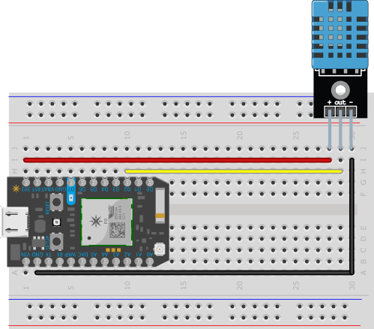
Architecture overview
PublishWeather Web Hook
DeviceHub Event Hub
PowerBIDump Stream Analytics Job
WeatherData Power BI Data Set

Slide 118
Architecture overview
PublishWeather Web Hook
DeviceHub Event Hub
PowerBIDump Stream Analytics Job
SensorData Power BI Data Set

Slide 119
Power BI LOGO

Slide 120
IoT Logo

Slide 121
arduino

Slide 122
GALILEO BOARD

Slide 123
RASPBERRY PI

Slide 124
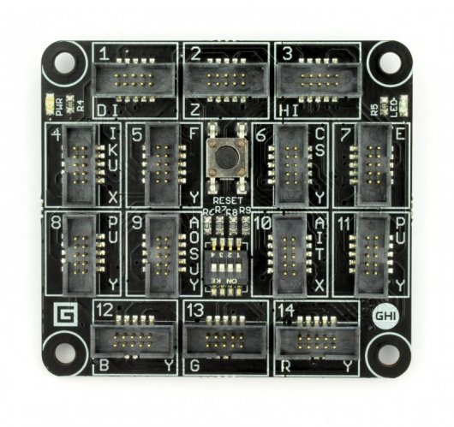
FEZ SPIDER MAIN BOARD

Slide 125
Sparkfun weather shield

Slide 126
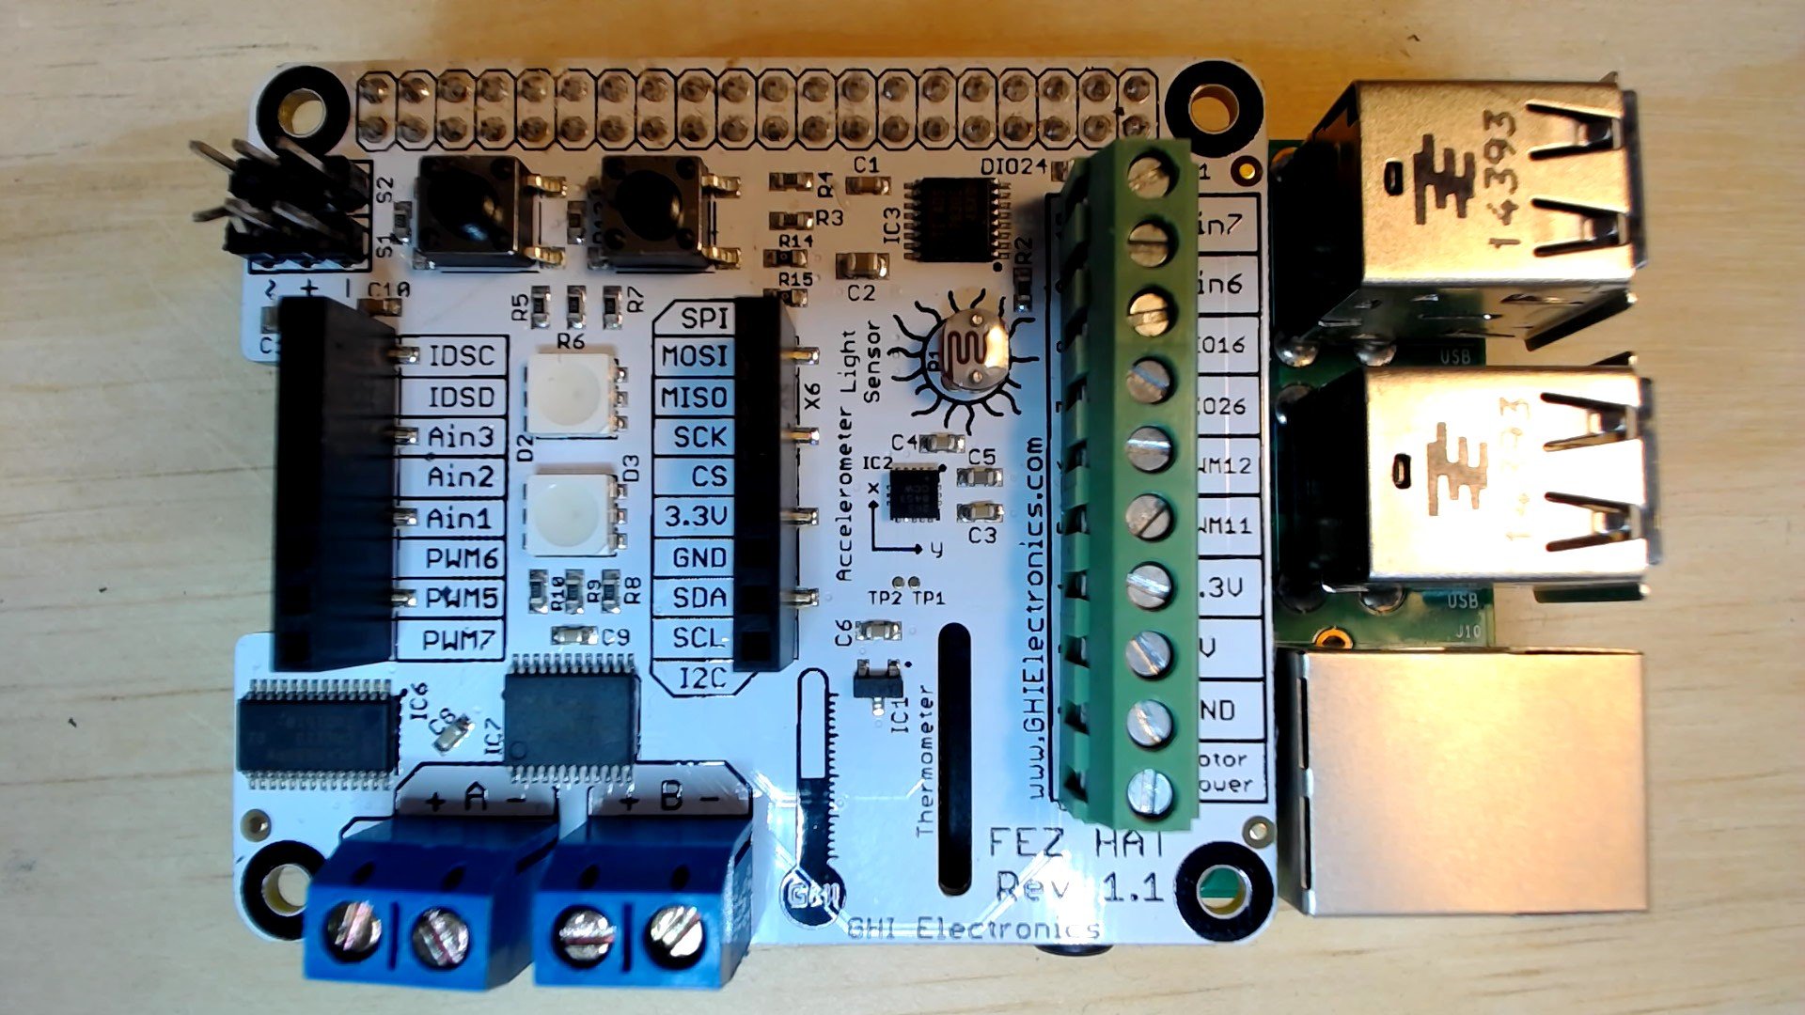
FEZ HAT

Slide 127
Connect the dots azure icons
Event Hubs
Stream Analytics
Storage
(
Azure
Microsoft Azure
Web App
Service Bus
)
Storage blob
Storage table
SQL database
HDInsight
Machine
(
Learning
GitHub code
Git repository
generic
)

Slide 128
LEDs

Slide 129
Resistors
220Ω
1st Digit
2nd Digit
Multiplier
Tolerance
Color | Name | 1st Digit | 2nd Digit | Multiplier | Tolerance
 | Black | 0 | 0 | X1
 | Brown | 1 | 1 | X10 | 1%
 | Red | 2 | 2 | X100
 | Orange | 3 | 3 | X1,000
 | Yellow | 4 | 4 | X10,000
 | Green | 5 | 5 | X100,000
 | Blue | 6 | 6 | X1,000,000
 | Violet | 7 | 7
 | Grey | 8 | 8
 | White | 9 | 9
 | Gold |  |  | X0.1 | 5%
 | Silver |  |  | X0.01 | 10%
330Ω
10KΩ

Slide 130
cables

Slide 131
More cables and adapters

Slide 132

LEDs
Anode (+)
Cathode (-)
Flat Edge
Small Post
Big Post
Long Leg
Short Leg
Vcc (+)
GND

Slide 133
LEDs

Slide 134
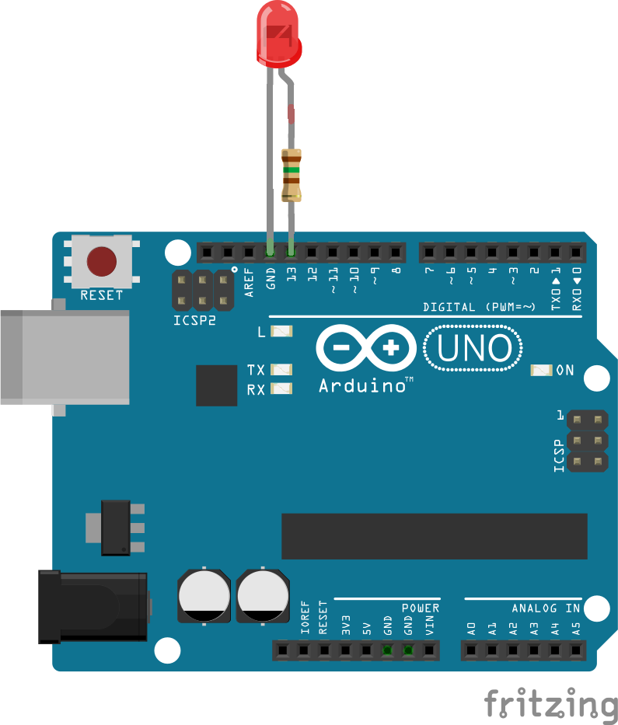
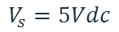
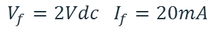
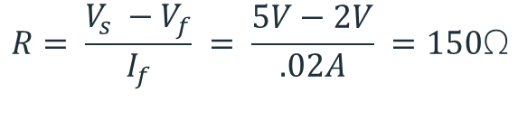
Current limiting resistors
Providing more current than an LED is rated for can destroy the LED. To prevent that, you should use a “Current Limiting” resistor.
To calculate the value of the resistor you need to know the supply voltage (Usually 5V on the Arduino Uno), and the LEDs rated Forward Voltage (the voltage drop across the LED) and Forward Current (the maximum current the LED can handle).
$$V_{f}=2Vdc I_{f}=20mA$$
$$Resistor Value (R)= \frac{Supply Voltage \left(V_{s}\right)−LED Forward Voltage (V_{f}) }{LED Forward Current (I_{f})}$$
$$V_{s}=5Vdc$$
$$R= \frac{V_{s} −V_{f}}{I_{f}} = \frac{5V−2V}{.02A} =150\text{Ω}$$
The Arduino Uno has a built in current limiting resistor on Pin 13. If you use Pin 13 to power your LED you can use it without a separate resistor.

Slide 135
Resistors
220Ω
1st Digit
2nd Digit
Multiplier
Tolerance
Color | Name | 1st Digit | 2nd Digit | Multiplier | Tolerance
 | Black | 0 | 0 | X1
 | Brown | 1 | 1 | X10 | 1%
 | Red | 2 | 2 | X100
 | Orange | 3 | 3 | X1,000
 | Yellow | 4 | 4 | X10,000
 | Green | 5 | 5 | X100,000
 | Blue | 6 | 6 | X1,000,000
 | Violet | 7 | 7
 | Grey | 8 | 8
 | White | 9 | 9
 | Gold |  |  | X0.1 | 5%
 | Silver |  |  | X0.01 | 10%
330Ω
10KΩ

Slide 136
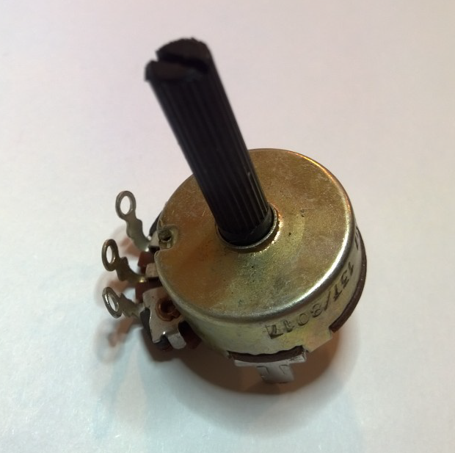
Potentiometer – variable resistor

Slide 137
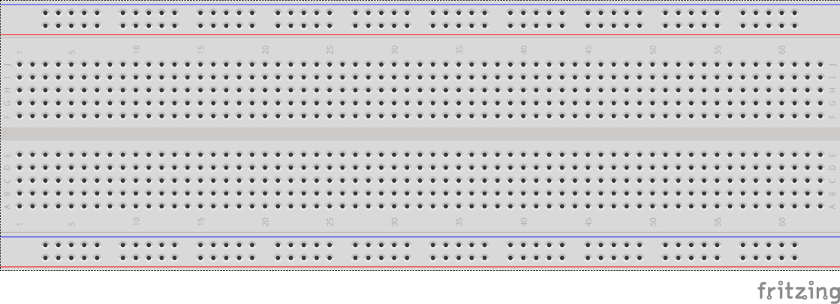
breadboards
Breadboards offer a great way to prototype circuits. The provide a number of “buses” for connecting both power and components.
Power buses run the entire horizontal length
Component buses give you easy ways to connect pins together

Slide 140
Micro SD Cards
Font: Segoe UI Semibold

